Slide 1
Helping educators better support students with FASD & reduce rates of adverse experiences
Carson Kautz-Turnbull
Emerging Researchers Session
FASD Impact Week 2024

Slide 2
Creativity
Determination
Hard work
Academics
Burles et al., 2018; Kautz-Turnbull et al., 2022; Stade et al., 2011; Timler & Olswang, 2001
Notes:
We know individuals with FASD have many strengths that are well suited to the classroom

Slide 3
Streissguth et al., 2004
Notes:
Yet we see high rates of school disruption, even for students in elementary school

Slide 4
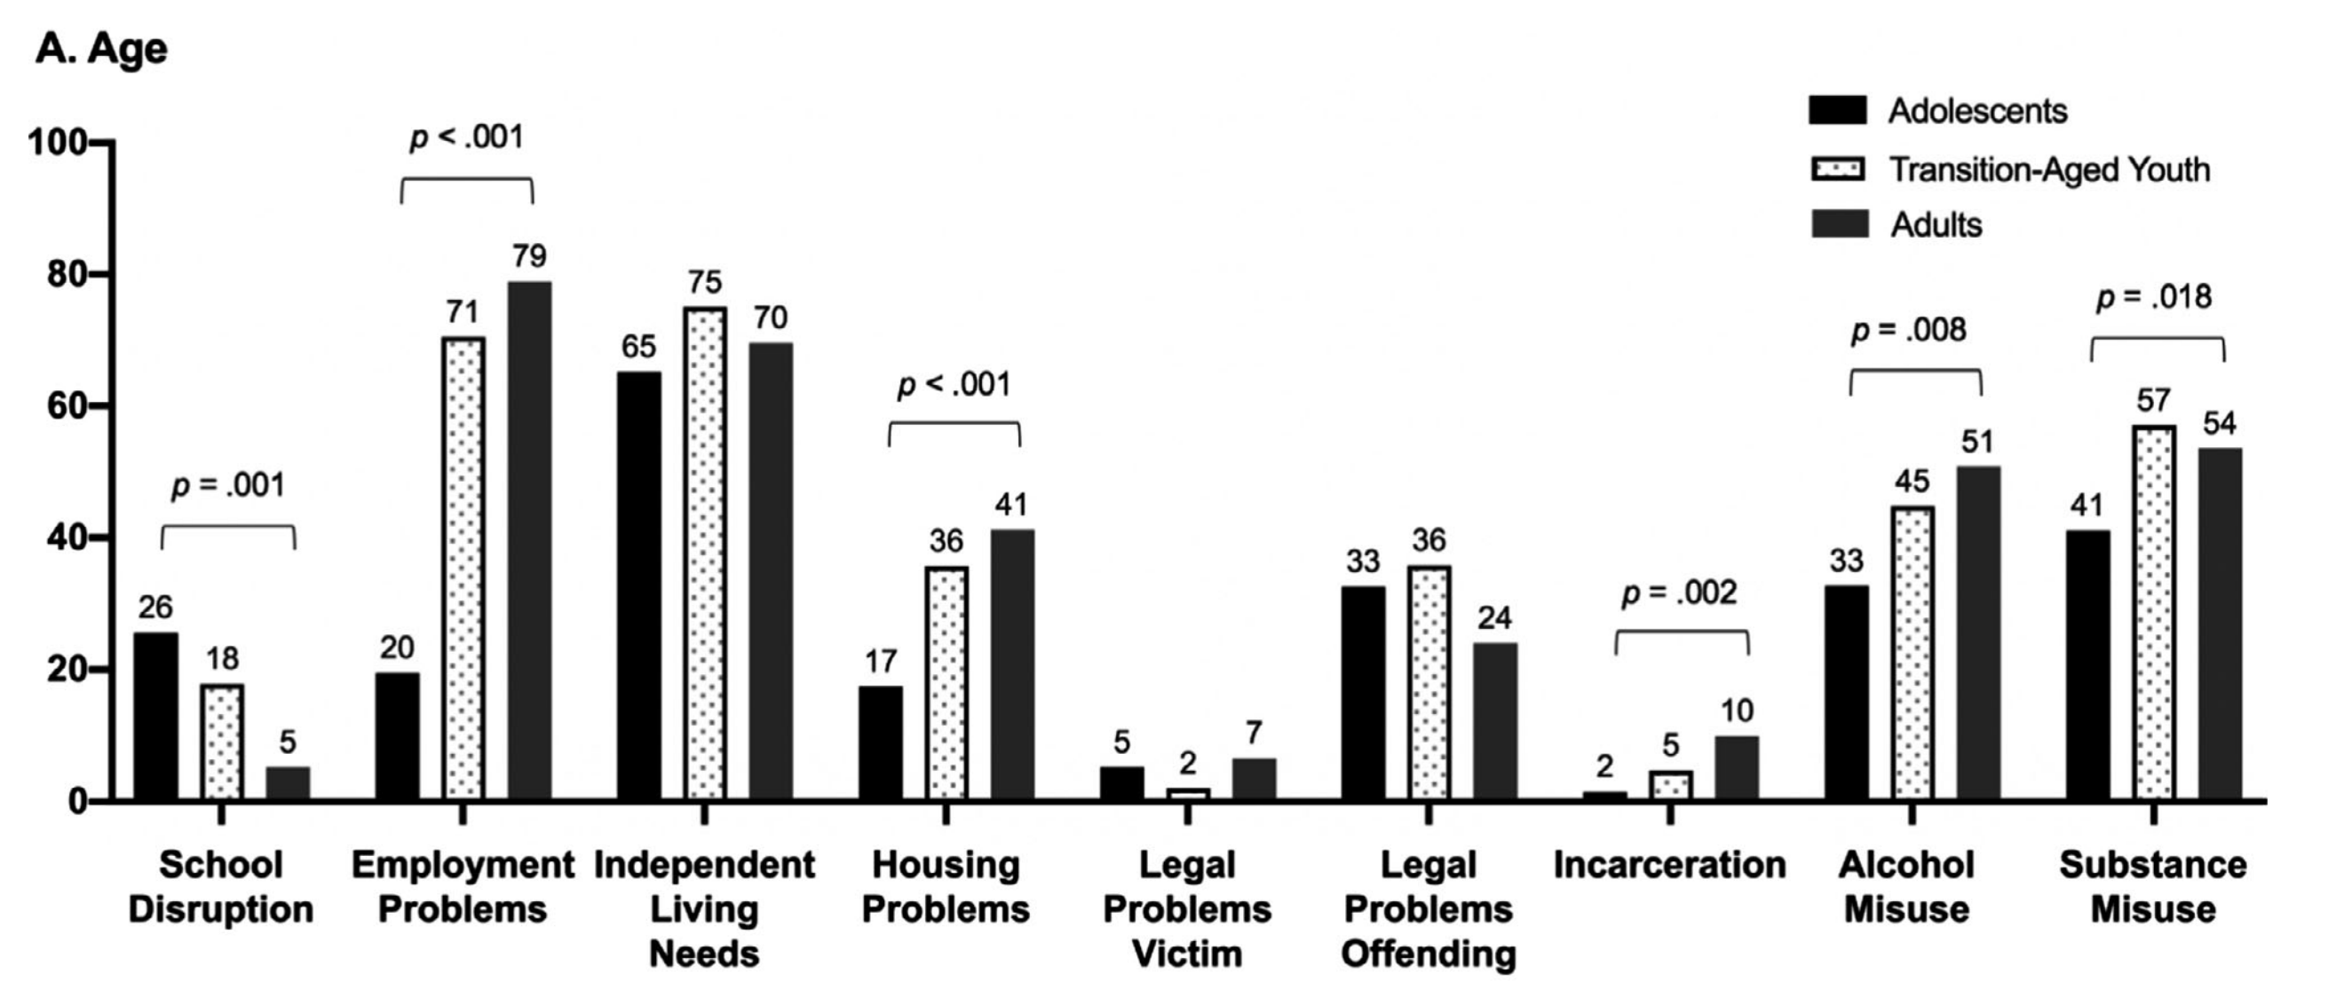
McLachlan et al., 2020
Notes:
Up to 26%

Slide 5
Notes:
To address this need, we adapted the FMF Program, an evidence based intervention for caregivers of children with FASD, and FMF Connect, which is a mobile health app for parents, to teachers and the classroom setting. We used the ADAPT-ITT framework, which is an in depth framework for adapting interventions to a new population. It was originally developed for HIV intevrentiosn but is used extensively to adapt interventions to new populations and new formats. In our case, we needed to adapt the FMF Program to a new population, teachers, and to a new format, a self-directed website.

Slide 8
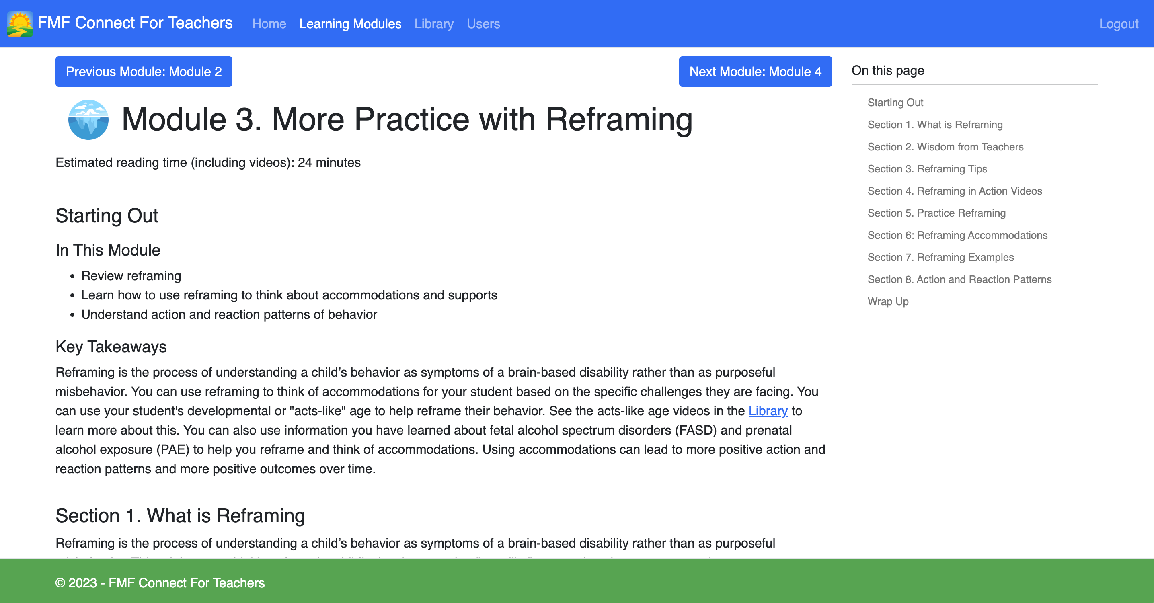

Slide 9
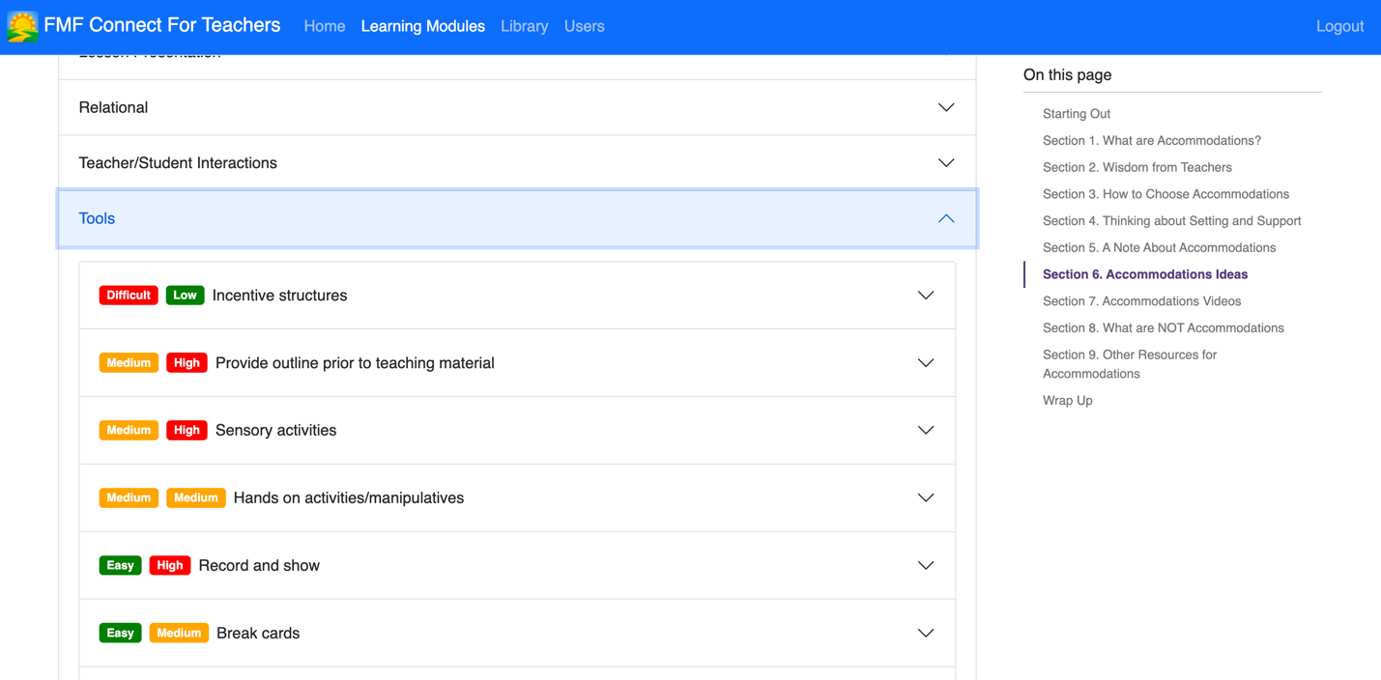

Slide 11
Baseline Trajectory
FMF Program Intervention
Theorized Change
Low knowledge of FASD
Increased knowledge of FASD
Psychoeducation
Willful
Attribution Modification
Neurodevelopmental
Consequence-based
Positive Behavior Support
Antecedent-based
Lower self-efficacy
Higher self-efficacy
Outcomes

Slide 12
1. Does it work?
2. Does it create change?
Notes:
Emphasize pilot trial!

Slide 13
Methods
K-5 teachers with a student with confirmed FASD or PAE
Study entirely online
Assessments:
Self-report surveys
Subset of participants completed a qualitative interview
Recruitment methods
Parents in FMF Connect trials
Randomly selected administrators from low-income schools
Social media

Slide 14
Technological functionality
Website acceptability
Enrollment and attrition
Study design acceptability
Notes:
- Main tech problem was school wifi blocking the website, requiring teachers to go to IT to get access to it
Usage data deleted
Other than that, website easy to navigate, all links and videos worked, etc.
Participants found the content on the website easy to understand, thorough, and credible. They liked that it was presented in a variety of formats.
Some found the amount of content overwhelming and thought that the website could be more visually engaging
Teachers liked reframing and accommodations the most – they reported revisiting these modules over and over again, using them in their classroom, and sharing them with others.
Group 1 > Group 2 on Information and Subjective Quality (timing)
Little to no technological problems
Highest rated uMARS scales:
Information: quality of content, credibility of source
Functionality: ease of use, smoothness of website
Lowest rated uMARS scales:
Subjective quality: overall rating of website, planned future use
FASD: website’s impact on student with FASD
All average scores above 3/6
these items focused on current and predicted behavior change, meaning these scores may indicate that though teachers felt the information was credible and the website functional, they did not intend to use the website long-term, and did not feel that it led to change in their student’s performance from day to day. Thus, teacher behavior change and student improvement may be more stable constructs which are less likely to see change, especially on a relatively short timescale.
Change in teaching:
Reframing
Applied material to entire classroom, especially reframing and accommodations
Many did not get to brainstorming
Use – 30 min or less at a time, new behavior challenge/hard day
Progressed through modules in order, but not linear (circled back)
Positives: Ease of navigation, ease of use, attractiveness
Presentation of information, effort validation, credibility, U.S.-specific content
Reframing content, accommodations content
Negatives: Visual engagement
Amount of content can be overwhelming
Demand of material

Slide 15
Baseline Trajectory
FMF Program Intervention
Theorized Change
Low knowledge of FASD
Increased knowledge of FASD
Psychoeducation
Willful
Attribution Modification
Neurodevelopmental
Consequence-based
Positive Behavior Support
Antecedent-based
Lower self-efficacy
Higher self-efficacy
Outcomes
Notes:
Revisit the logic model for the last two aims – are the assessment sensitive to change on this timeline and if so what is the direction of change?

Slide 16
Measured by:
Theorized Change
Knowledge & Advocacy Questionnaire
Increased knowledge of FASD
Reasons for Children’s Behavior
Neurodevelopmental
Behavioral Strategies
Antecedent-based
Teacher Self-Efficacy Scale
Higher self-efficacy

Slide 17
Measured by:
Theorized Change
Pilot Effect
Knowledge & Advocacy Questionnaire
Increased knowledge of FASD
Mixed
Notes:
K&A
Total score: no effect
Learned most of information without access to website
Large effect on self-assessment
However, it should be noted that it is also possible participants were prompted by the act of taking the K&A survey to search out the answer to the questions and thus improved their scores at the next timepoint. This phenomenon is called the “Hawthorne effect”, a reference to a series of studies completed during the 1920s in which workers increased productivity while participating in the study but declined once the study finished (Sedgwick & Greenwood, 2015). The Hawthorne effect has been shown to affect results in clinical trials (e.g., McCarney et al., 2007), though some argue the effect is an artifact of experimental design (Jones, 1992). It’s possible teachers were impacted by the feeling of being “tested” (observed) and thus were motivated to increase their knowledge regardless of their group assignment. This is consistent with one participant recommendation which was to provide participants with their scores on the measures, suggesting some were motivated to achieve “high scores” on the surveys.

Slide 18
Measured by:
Theorized Change
Pilot Effect
Knowledge & Advocacy Questionnaire
Increased knowledge of FASD
Mixed
Reasons for Children’s Behavior
Neurodevelopmental
Increase in all
Notes:
Teachers had lower endorsements of willful attributions compared to parents
Intervention change
Associated with increased endorsement of neurodevelopmental attributions at T2
Especially Sensory seeking and task ability
Thus, differences in willful attribution endorsement could be due to teachers having specific training in child development and developmental expectations, and exposure to many different children and behaviors (Buettner et al., 2016; Daniels & Shumow, 2003; Haslip & Gullo, 2018), helping them better understand challenging behavior and preventing them from making more willful attributions

Slide 19
Measured by:
Theorized Change
Pilot Effect
Knowledge & Advocacy Questionnaire
Increased knowledge of FASD
Mixed
Reasons for Children’s Behavior
Neurodevelopmental
Increase in all
Behavioral Strategies
Antecedent-based
Positive effect
Notes:
Potential buffering effect of the website on impressions of accommodations
Website associated with decrease in positive impressions of consequence-based strategies
Associated with improvement in impressions of accommodations (decreasing impressions for Group 2, steady for Group 1 – buffering effect?), Group 1 decreased in impressions of punishment – replicated in G2
It should be noted that these results are specific to teachers’ perceptions of the usefulness of these strategies and not about their implementation of these strategies

Slide 20
Opinions of antecedent-based strategies
Opinions of consequence-based strategies
Website Group
Control Group

Slide 21
Measured by:
Theorized Change
Pilot Effect
Knowledge & Advocacy Questionnaire
Increased knowledge of FASD
Mixed
Reasons for Children’s Behavior
Neurodevelopmental
Increase in all
Behavioral Strategies
Antecedent-based
Positive effect
Notes:
Potential buffering effect of the website on impressions of accommodations
Website associated with decrease in positive impressions of consequence-based strategies
Associated with improvement in impressions of accommodations (decreasing impressions for Group 2, steady for Group 1 – buffering effect?), Group 1 decreased in impressions of punishment – replicated in G2
It should be noted that these results are specific to teachers’ perceptions of the usefulness of these strategies and not about their implementation of these strategies

Slide 22
Measured by:
Theorized Change
Pilot Effect
Knowledge & Advocacy Questionnaire
Increased knowledge of FASD
Mixed
Reasons for Children’s Behavior
Neurodevelopmental
Increase in all
Behavioral Strategies
Antecedent-based
Positive effect
Teacher Self-Efficacy Scale
Higher self-efficacy
No effect
Notes:
No change
Small improvement in efficacy at T3 for G1, delayed change
Some evidence for a slight effect of timing in school year but a larger trial is needed to parse these apart.
Most notably the knowledge total score
Critial period: early
K&A total score
All attributions greater
Rewards
Critical period: late
organize/routine accommodations
No effect of timing
K&A self assessment
Simplify/remind accommodations, consequences
Efficacy

Slide 23
Future Directions
Improvements/considerations
Recruitment of more diverse participants
Testing of causal outcomes
Dissemination and implementation
Notes:
Suggested start points
Who is this for – everyone/only if student with FASD
Top down recruitment approach
Broader recruitment
Testing different recruitment strategies
Testing of pathways of logic model
Timing throughout year
Practice change outcomes

Slide 24
Why is intervening in school so important?

Slide 25
McLachlan et al., 2020
Notes:
Up to 26%

Slide 26
Current Research
Prenatal alcohol exposure
Trouble with the law
Risky behavior
Lower academic achievement
Poorer mental health

Slide 27
Education Research
Suspension and expulsion
Trouble with the law
Risky behavior
Lower academic achievement
Poorer mental health
Notes:
School to prison pipeline – youth who experience suspension and expulsion are more likely to have trouble with the law and be incarcerated
Increased aggressive behavior, substance misuse, increased offending (controlling for baseline offending)
ONE EDP event associated with almost a 1-point decrease in GPA
Increases likelihood of depression and anxiety

Slide 28
New framework
Suspension and expulsion
Trouble with the law
Risky behavior
Lower academic achievement
Poorer mental health
Prenatal alcohol exposure

Slide 29
Streissguth et al., 2004
Notes:
Yet we see high rates of school disruption, even for students in elementary school

Slide 30
Implications
Some adverse life experiences may be in part due to early suspension and expulsion
Intervening in school, especially early, may help to prevent adverse life experiences in adolescence and adulthood

Slide 31
Acknowledgements
NICHD F31 HD106625
Thrive FASD Lab
Mentor and consultant team

Slide 32
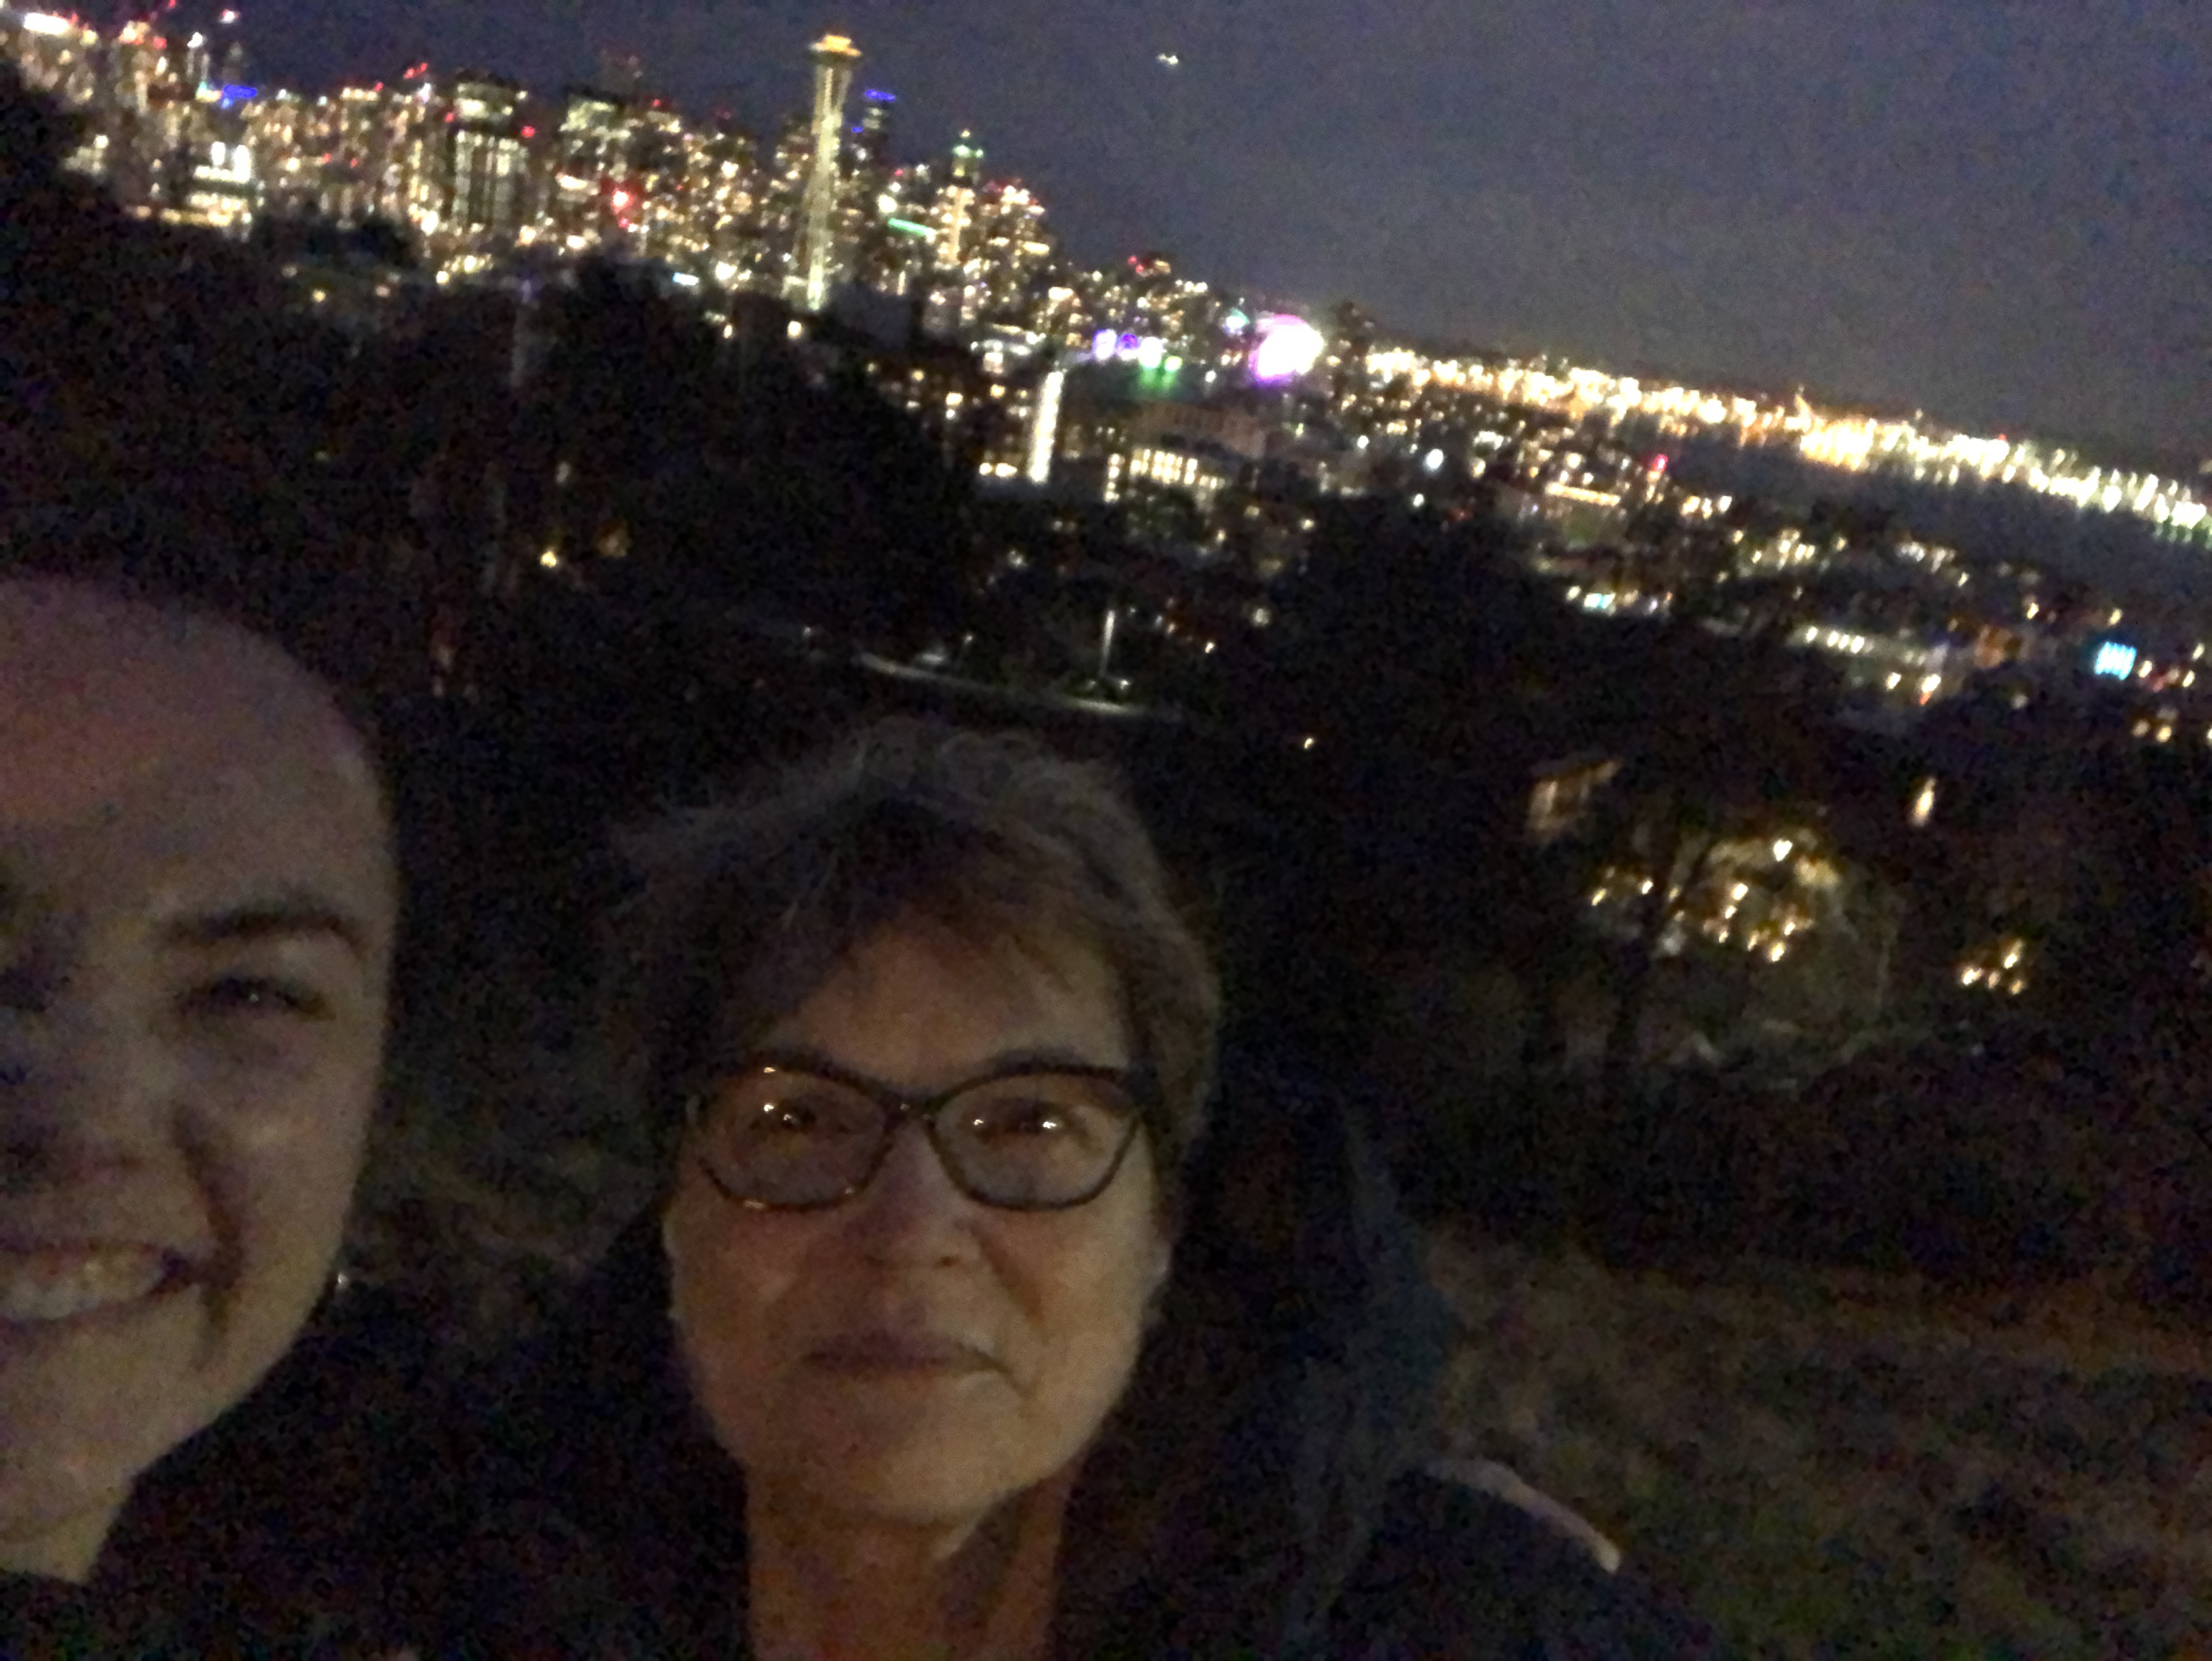
Thank you!!!

