Slide 1
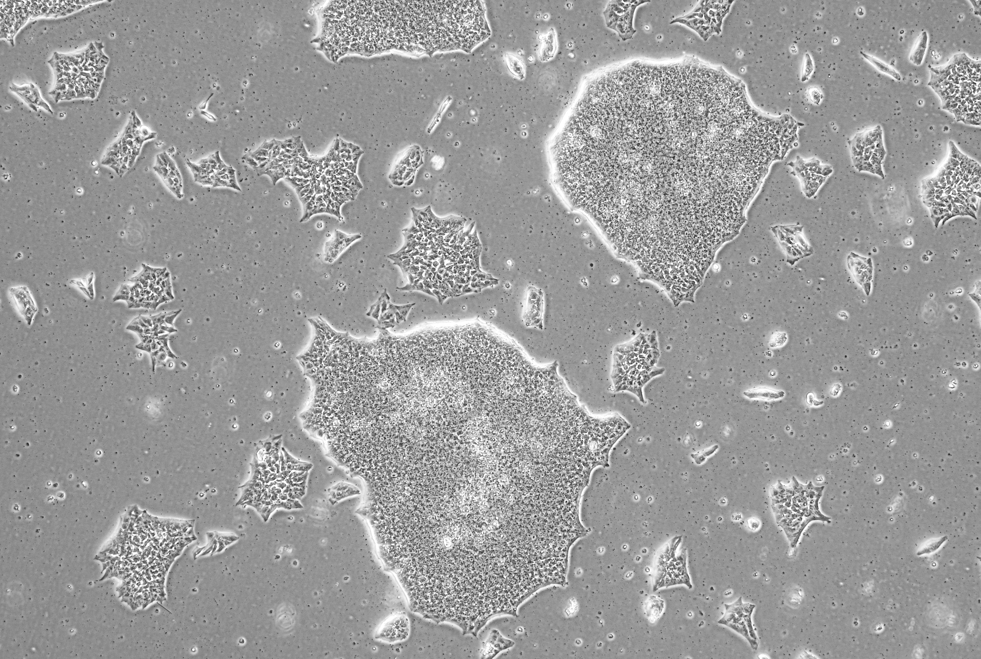

Understanding the impact of PAE on stem cells & healthy aging in people with FASD
Amanda H. Mahnke, PhD
Assistant Professor
Department of Neuroscience and Experimental Therapeutics
Texas A&M University College of Medicine
mahnke@tamu.edu
Emerging Researchers FASD Impact Week
18 Sept 2024
Notes:
hear from emerging researchers who will describe their research and its practical applications for the field.
This would be a facilitated session with a 15-minute presentation followed by a 5-minute Q&A. We will provide each speaker with curated audience feedback to support career growth. We are hoping for a mix of clinical and basic science.

Slide 2
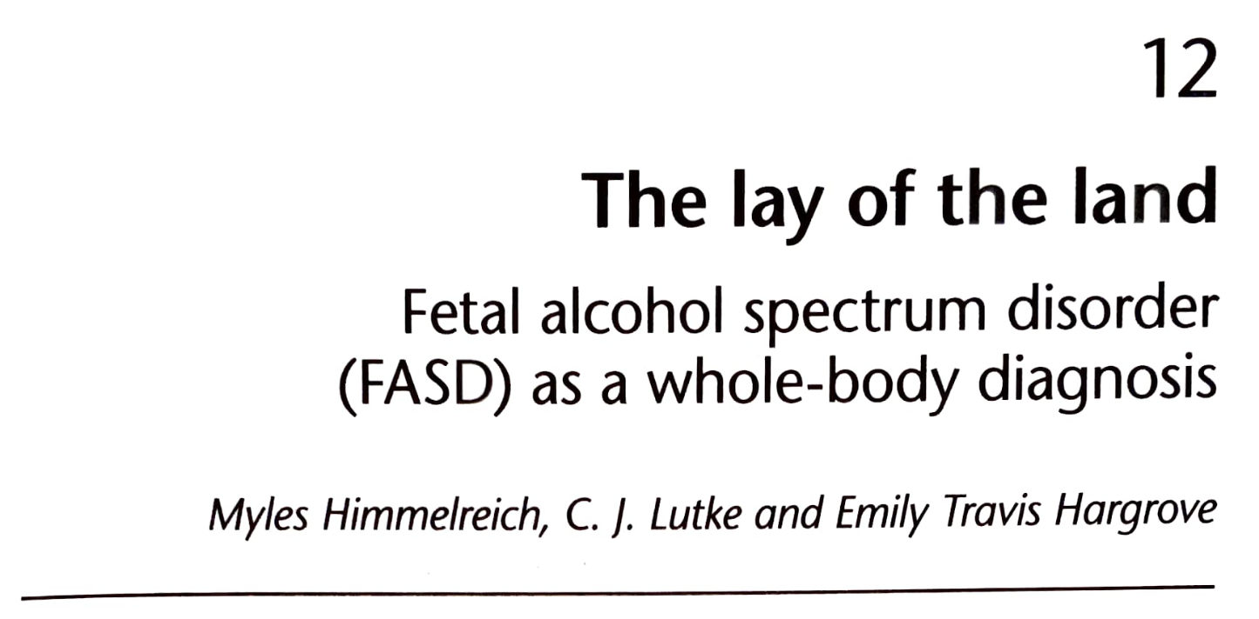
Adults with FASDs report early onset of aging related phenotypes
Average age of respondents:
27 years of age
Himmelreich et al., 2020 Routledge Handbook of Social Work

Slide 3
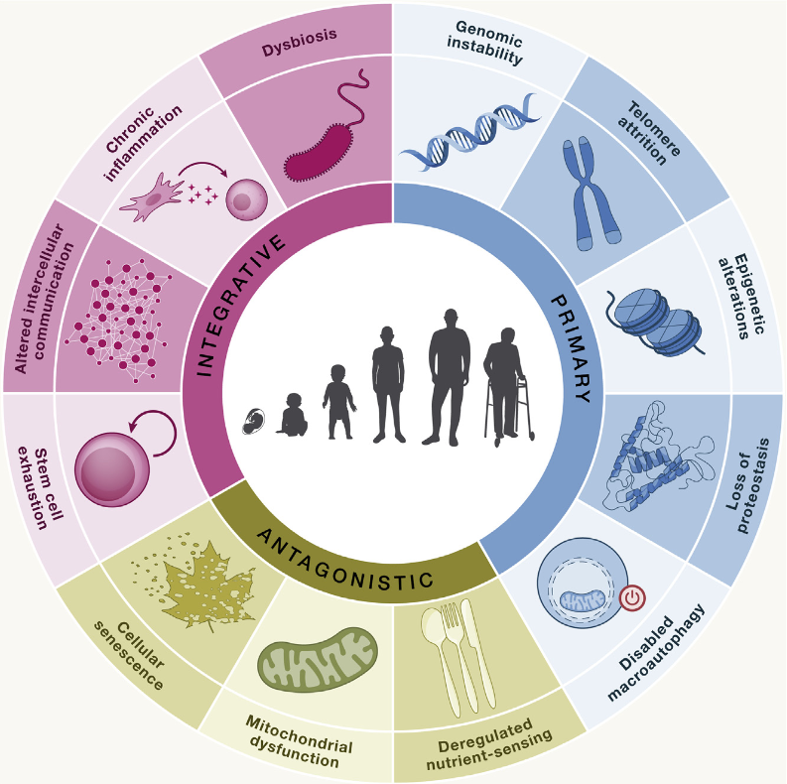
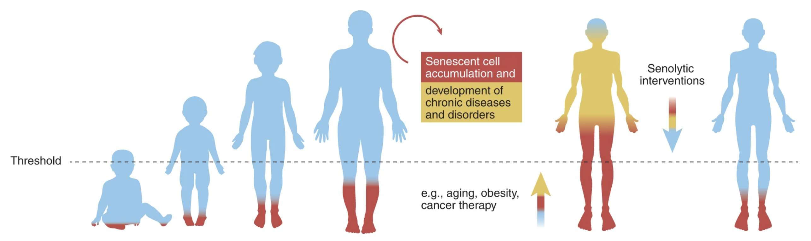
Stem cells are a key hallmark of aging; high levels of aged stem cells (senescent) can negatively affect health
Aging
Diabetes
Cardiac issues
Arthritis
López-Otín, C et al. (2023) Cell doi:10.1016/j.cell.2022.11.001
Adapted from Chaib, S et al. (2022) Nat Med doi: 10.1038/s41591-022-01923-y

Slide 4
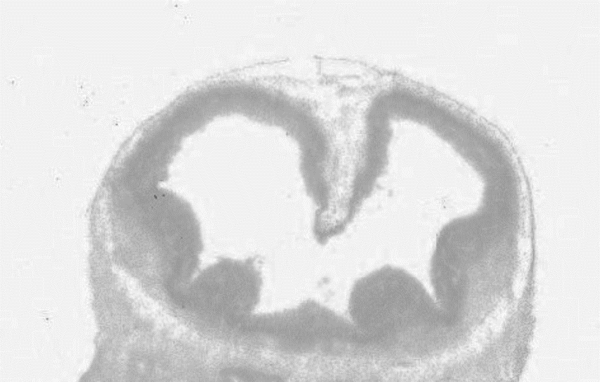
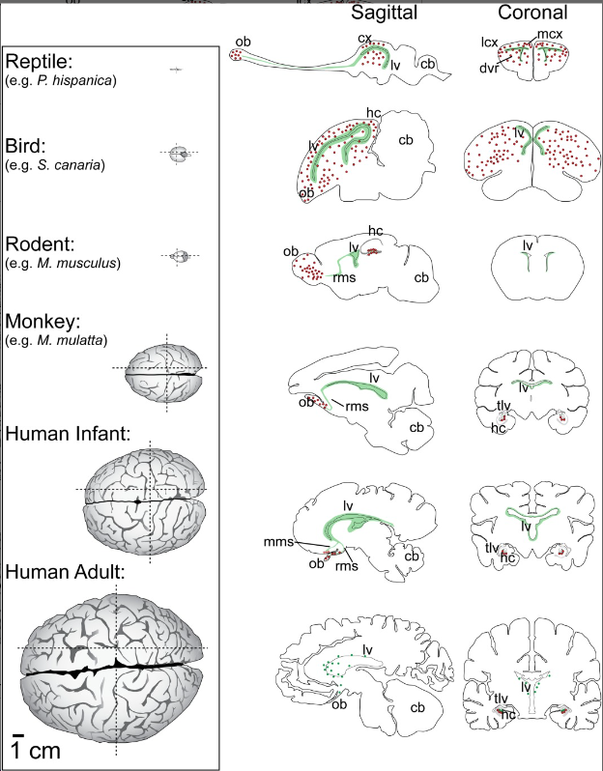
What evidence do we have about PAE impacting stem cells?
lv = Lateral Ventricle
lv
Paredes, MF et al. (2016) Journal of Comparative Neurology doi: 10.1002/cne.23896
https://developingmouse.brain-map.org/static/atlas

Slide 5
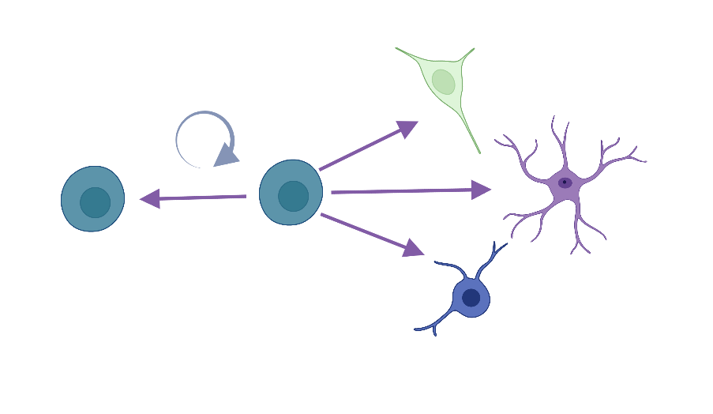
Neural stem cells are multipotent
Neurons (long distance signalers)
Neural stem cells
Astrocytes (short distance
signal coordination/cleanup)
Oligodendrocytes (signaling insulator)
Created with BioRender.com

Slide 6
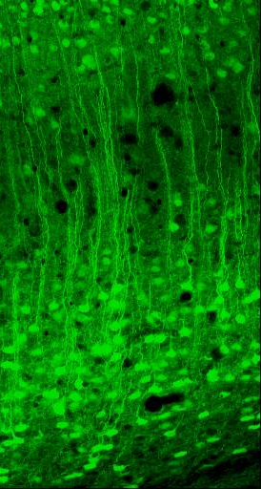
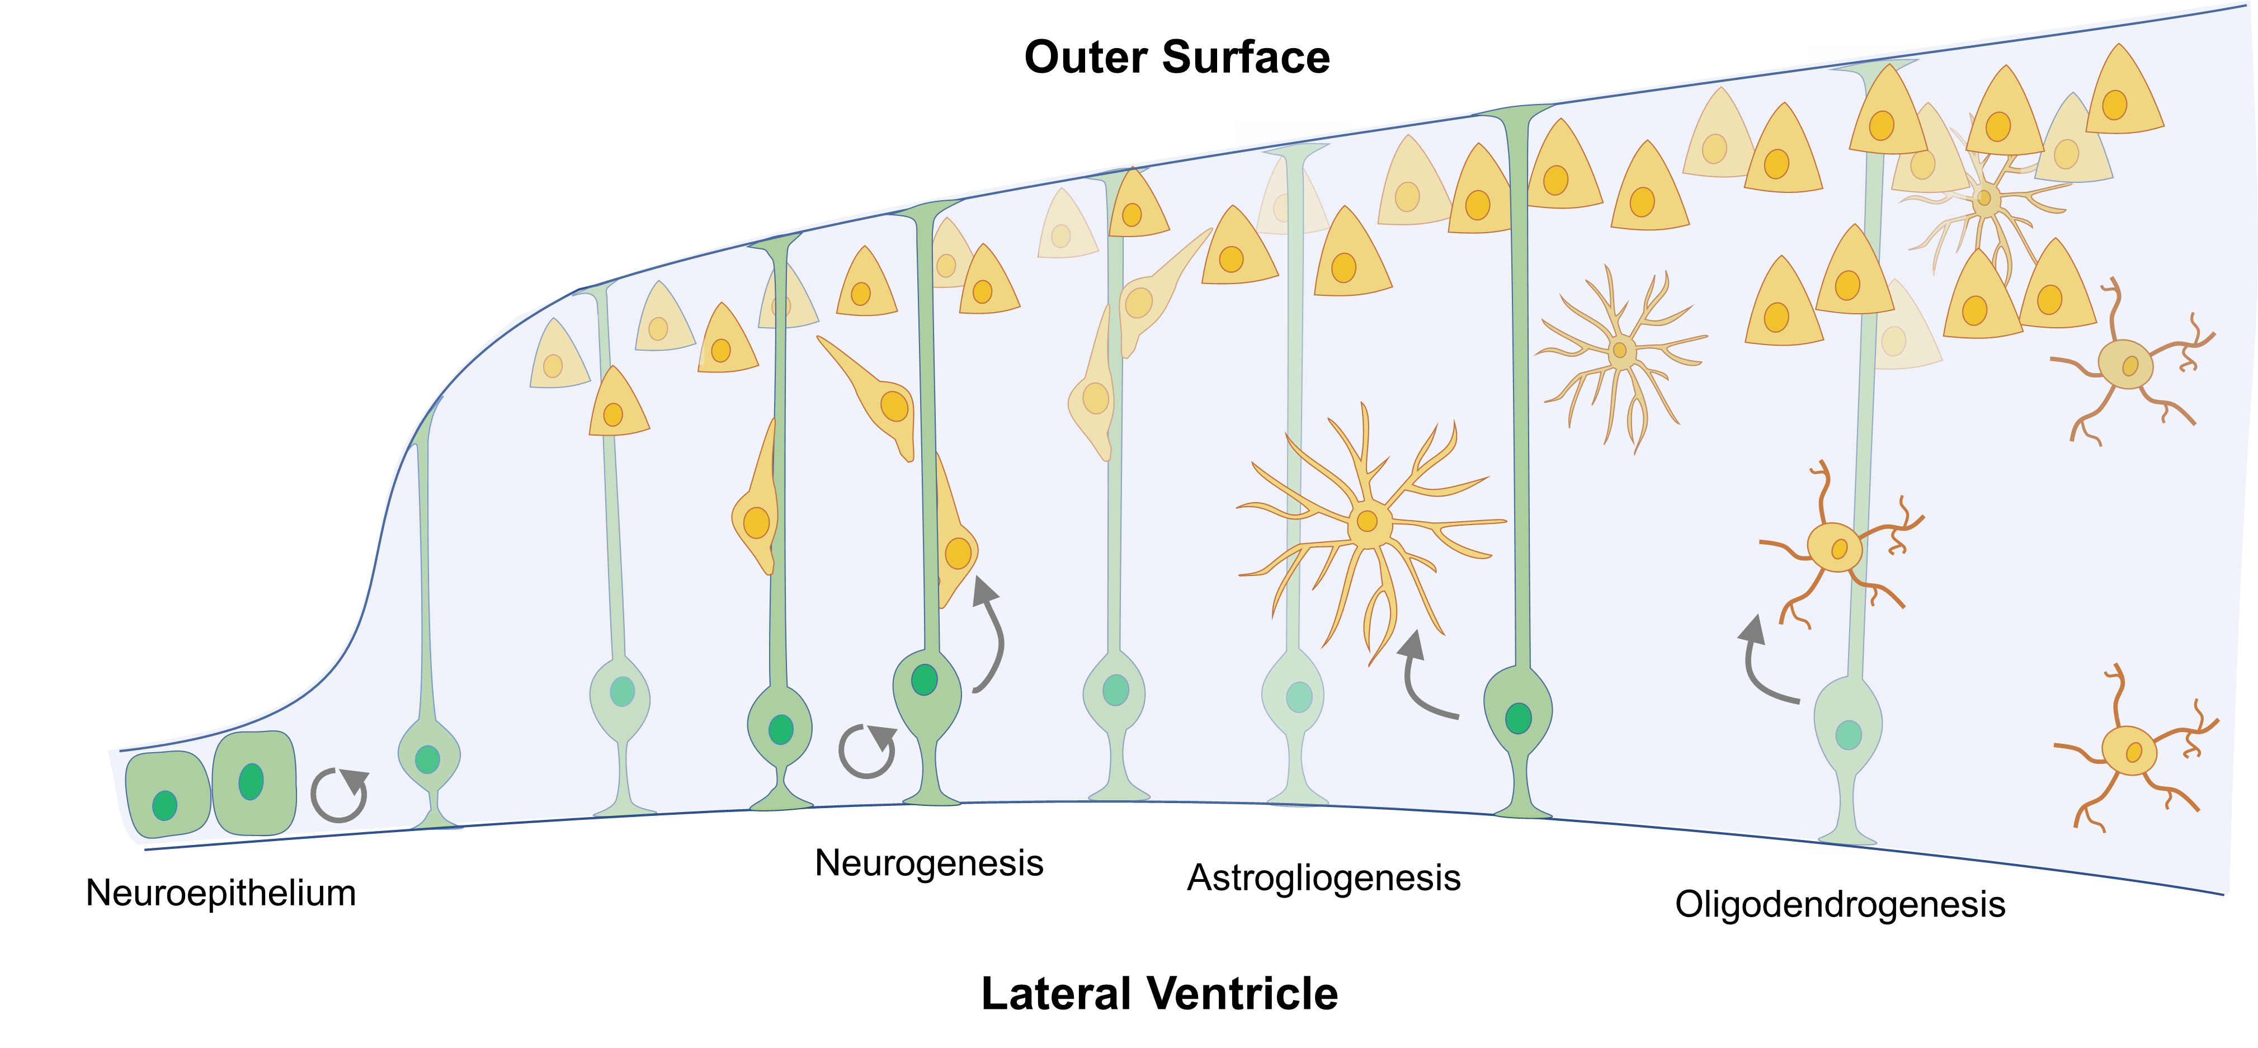
Neural stem cells are multipotent
Arc
Adapted from Mahnke, AH et al. (2019) Current Opinion in Toxicology doi: 10.1016/j.cotox.2019.08.002
https://www.gensat.org/imagenavigator.jsp?imageID=21508

Slide 7
Mouse neural stem cell culture model
GD12.5
(~Early second trimester)
Developing Cortex
lv
https://developingmouse.brain-map.org/static/atlas

Slide 8

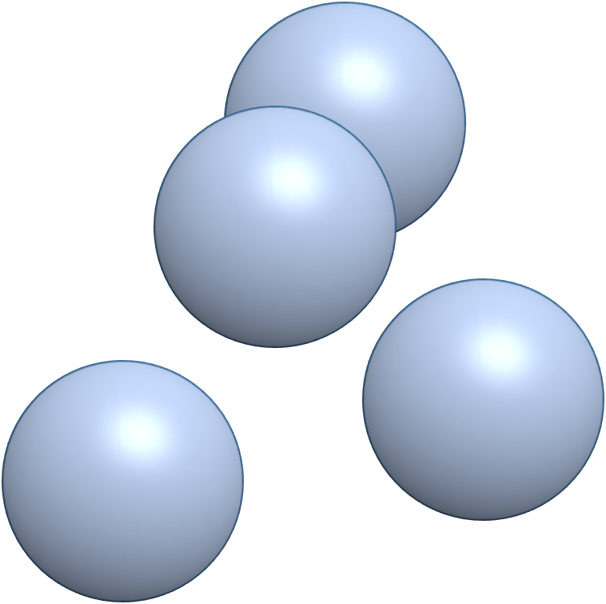
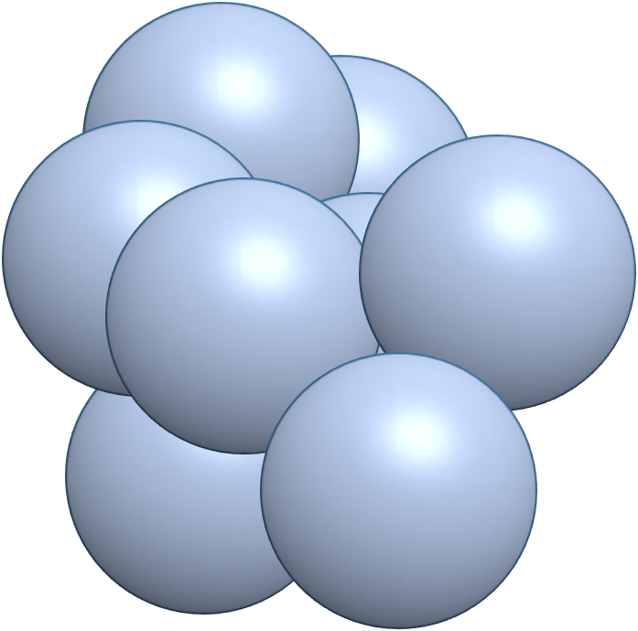

Mouse neural stem cell culture model
GD12.5
(~Early second trimester)
Developing Cortex
0d
5d
Males
lv
Females
https://developingmouse.brain-map.org/static/atlas

Slide 9
Mouse neural stem cell culture model
GD12.5
(~Early second trimester)
Developing Cortex
0d
5d
Males
lv
Females
https://developingmouse.brain-map.org/static/atlas

Slide 10
What evidence do we have about PAE impacting stem cells?
EXHAUSTION
Neurons (long distance signalers)
Astrocytes (short distance
signal coordination/cleanup)
Neural stem cells
Oligodendrocytes (signaling insulator)
Decreased RNA and protein stem cell marker expression (Santillano et al., 2005, Salem et al., 2021 Neurotoxicol Teratol)
Decreased expression of small RNAs (microRNAs) that block differentiation signaling(Saythan et al., 2007 J Neurosci)
Increased differentiation lineage markers (Salem et al., 2021 Neurotoxicol Teratol)
Decreased miRNAs enhances expression of astrocyte lineage genes(Tsai et al., 2014 Biol Open)
Created with BioRender.com

Slide 11


Male and female neural stem cells are not impacted equally
ΔΔC_{T}
mRNA Expression
Low
High
Low
High
Nes
a
a
a
a
a
a
a
Neural stem cells
a
P_{sexXetoh} < 0.001
Gfap
b
b
b
a
a
a
a
b
Astrocytes (short distance signal coordination/cleanup)
a
b
P_{sexXetoh} < 0.001
Glast
a,b
b
a,b
a,b
a
a
a
a
a
b
P_{sexXetoh} < 0.001
Rbfox3/NeuN
a
a
Neurons (long
distance signalers)
a
a
P_{etoh} = 0.018
Control
Control
60 mg/dL
60 mg/dL
120 mg/dL
120 mg/dL
320 mg/dL
320 mg/dL

Slide 12
Evidence of altered neural stem cell function into adolescence following PAE
Neurons (long distance signalers)
Astrocytes (short distance
signal coordination/cleanup)
Neural stem cells
Oligodendrocytes (signaling insulator)
Decreased neurosphere formation
Decreased neuron precursor production
What about adults?
Roitbak, T et al. (2011). Experimental Neurology doi:10.1016/j.expneurol.2011.03.007
Notes:
Moderate 84 ± 4.5 mg/dl
What about adults?

Slide 13

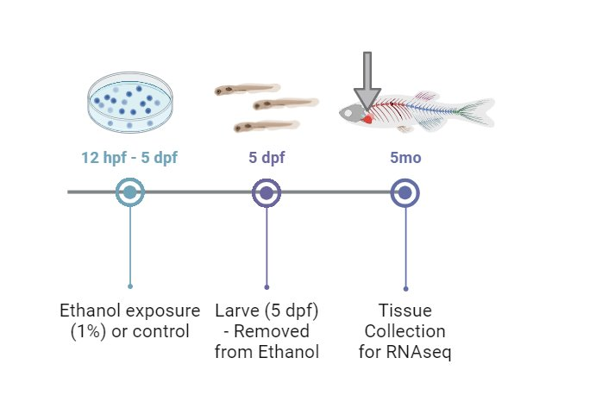
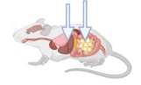


Evidence of early tissue aging in peripheral tissues
Jade Griffin, MPH
Cardiac aging RNA signature
Zebrafish 36 v 12mo
Rats 24 v 9mo
Liver aging
RNA signature
Rats 18-27 v 6mo
Adipose aging
RNA signature
Rats 12 v 5mo
Humans 30-70s v 20s
Males
Females
Significantly altered by PAE in the aging direction
Altered by PAE in the aging direction, not significant
Not altered by PAE
What about humans?
Data courtesy of Olivia Weeks, PhD
Weeks, O. et al.(2024) Cardiovascular Research doi:10.1093/cvr/cvae139

Slide 14
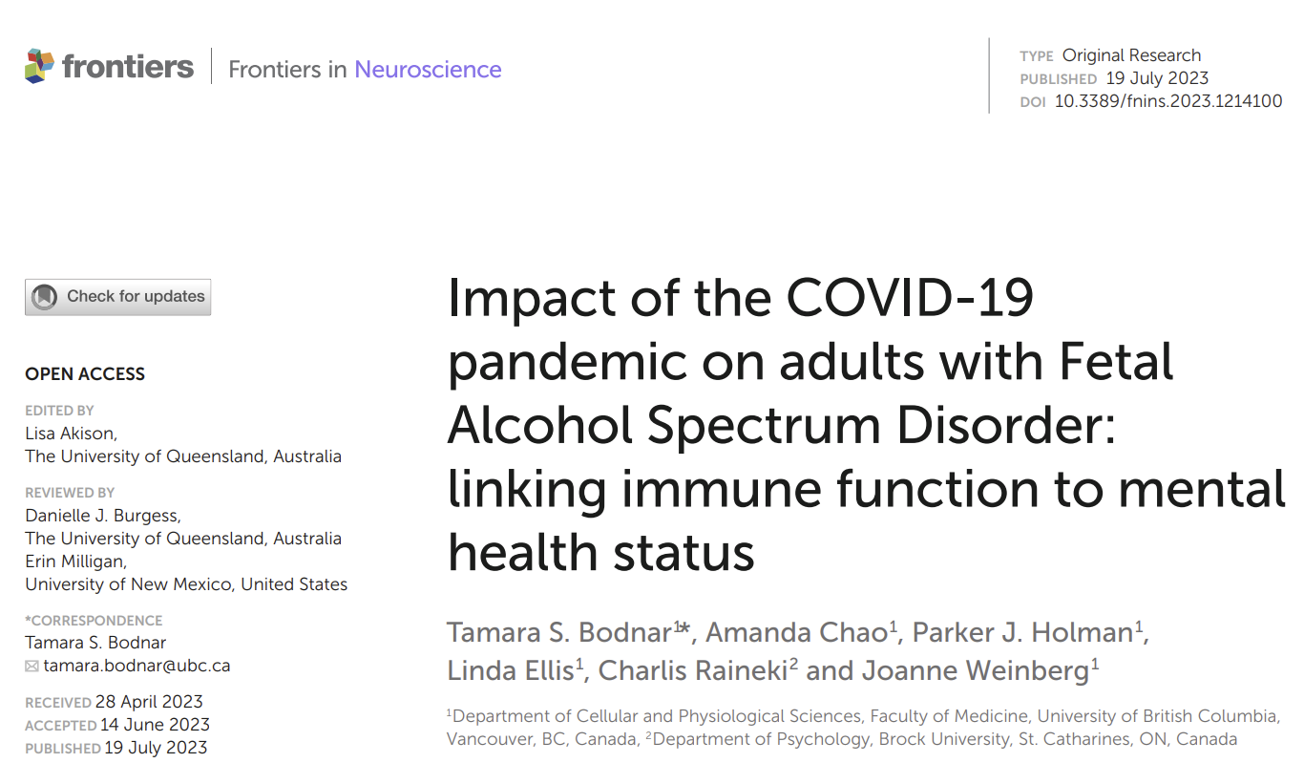
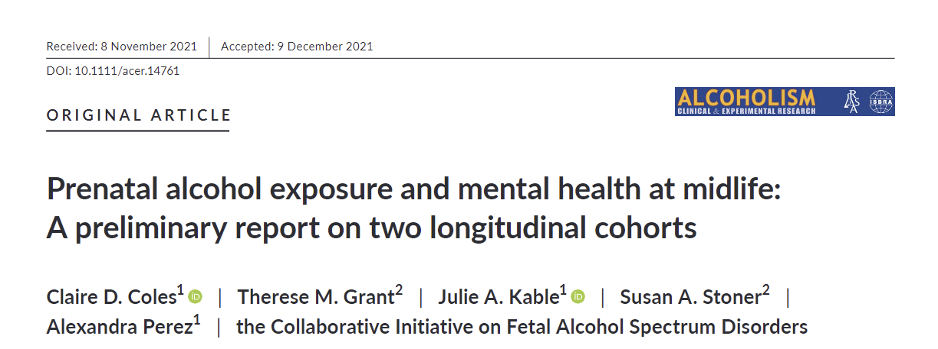
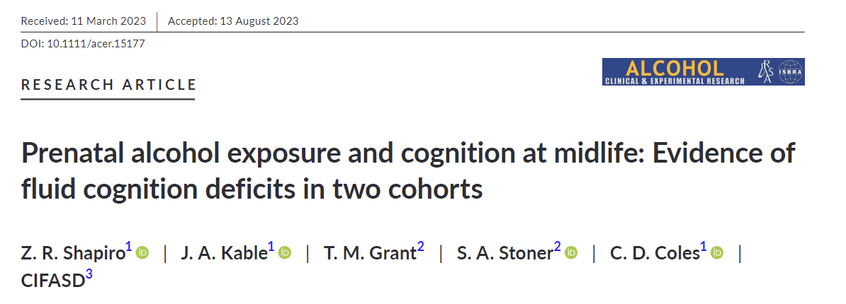
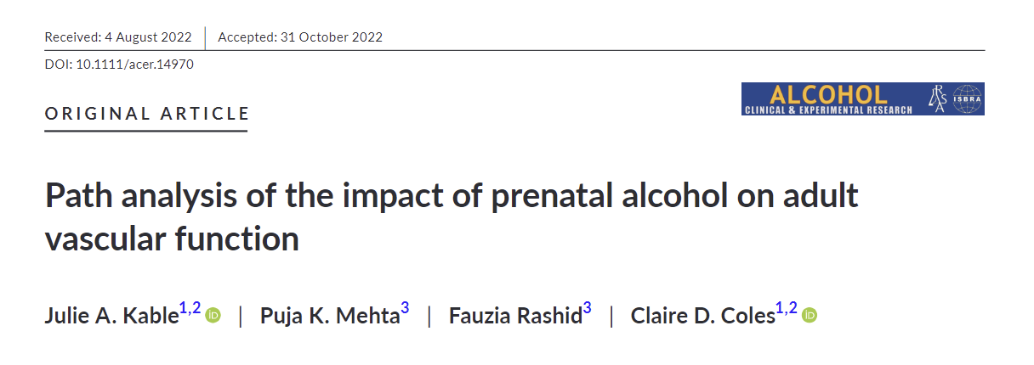
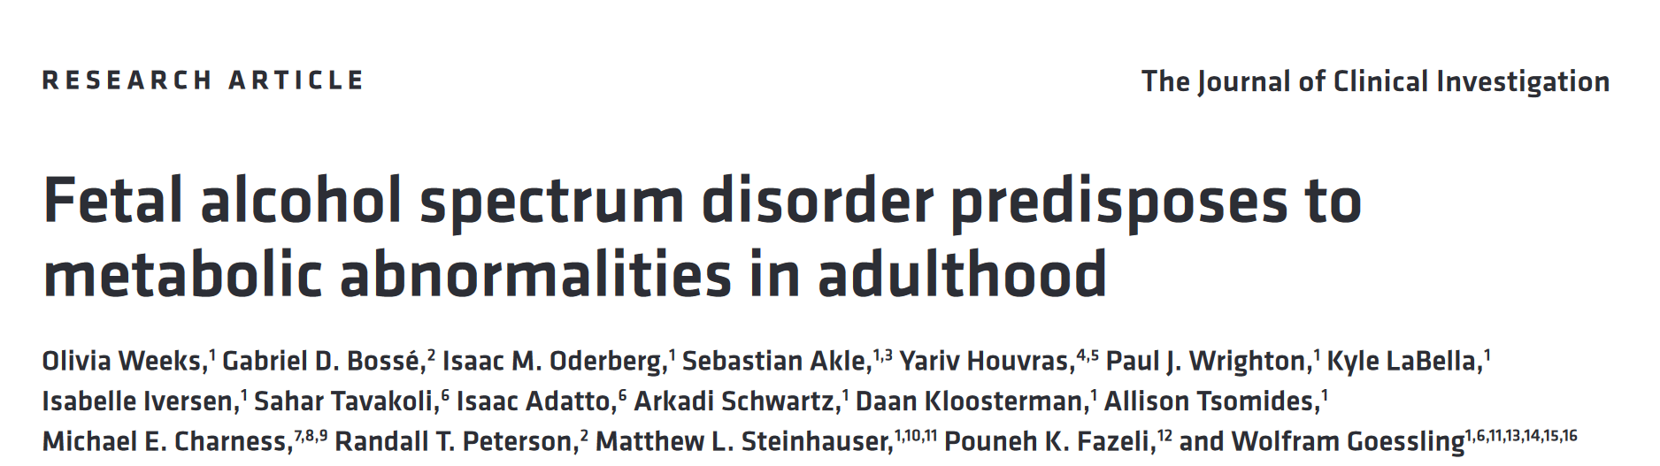
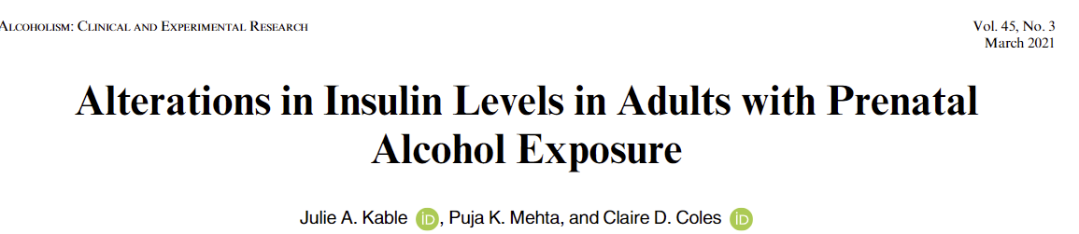
Aging after PAE

Slide 15
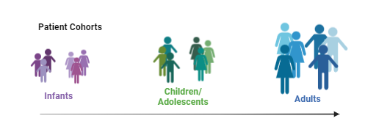






Collaborators for patient samples to investigate human stem cells
Ralph DiClemente
NYU
Tamara Bodnar
University of Calgary
Angela Stotts
McGovern Medical School
Christina Chambers
UCSD
Charlis Raineki
Brock University
UH2AA030186 (AHM PI)
UH2AA030186 (AHM PI)

Slide 16
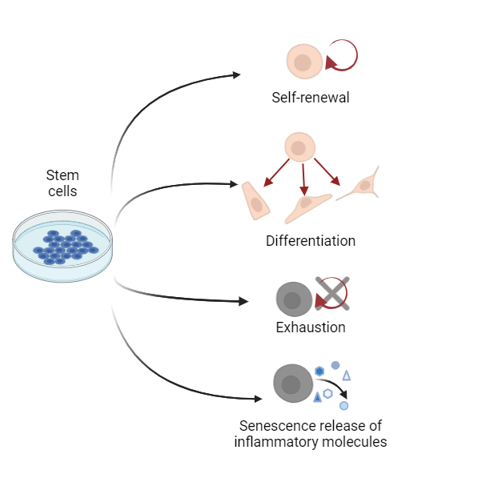
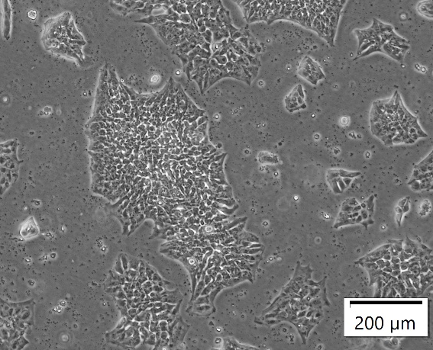
Human stem cells in culture

Slide 17

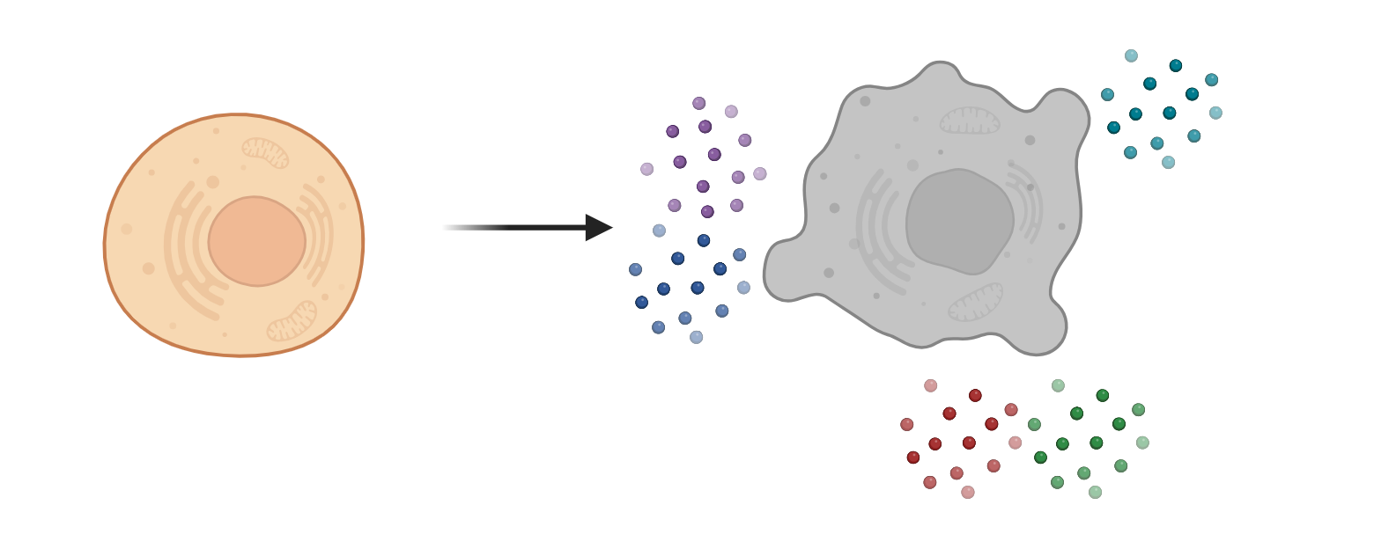
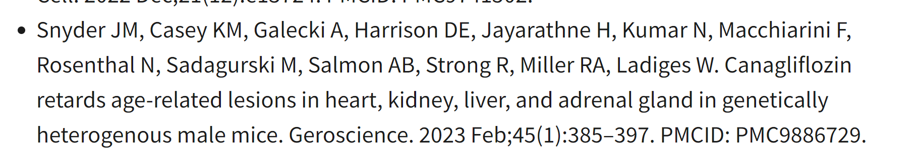
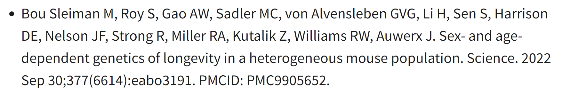
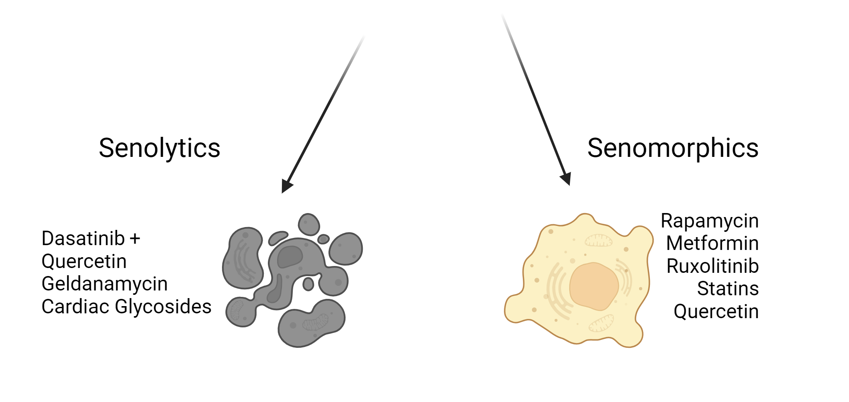
Potential for therapies (10-15 year plan)?
https://www.nia.nih.gov/research/dab/interventions-testing-program-itp
All have different mechanisms of action – which one is the best?
Do these work similarly in both sexes?

Slide 18
Summary
Animal models indicate that PAE
  Impacts stem cell health/behavior in early development and adolescence likely in a sex-dependent manner
  Induces the expression of genes associated with aging in the heart, liver, and adipose
Ongoing studies with samples from patient populations will show if human stem cells are impacted similarly to animal model stem cells
Long-term goal is to leverage animal models and human cells to identify potential therapeutics to improve healthy aging for individuals with PAE/FASDs

Slide 19
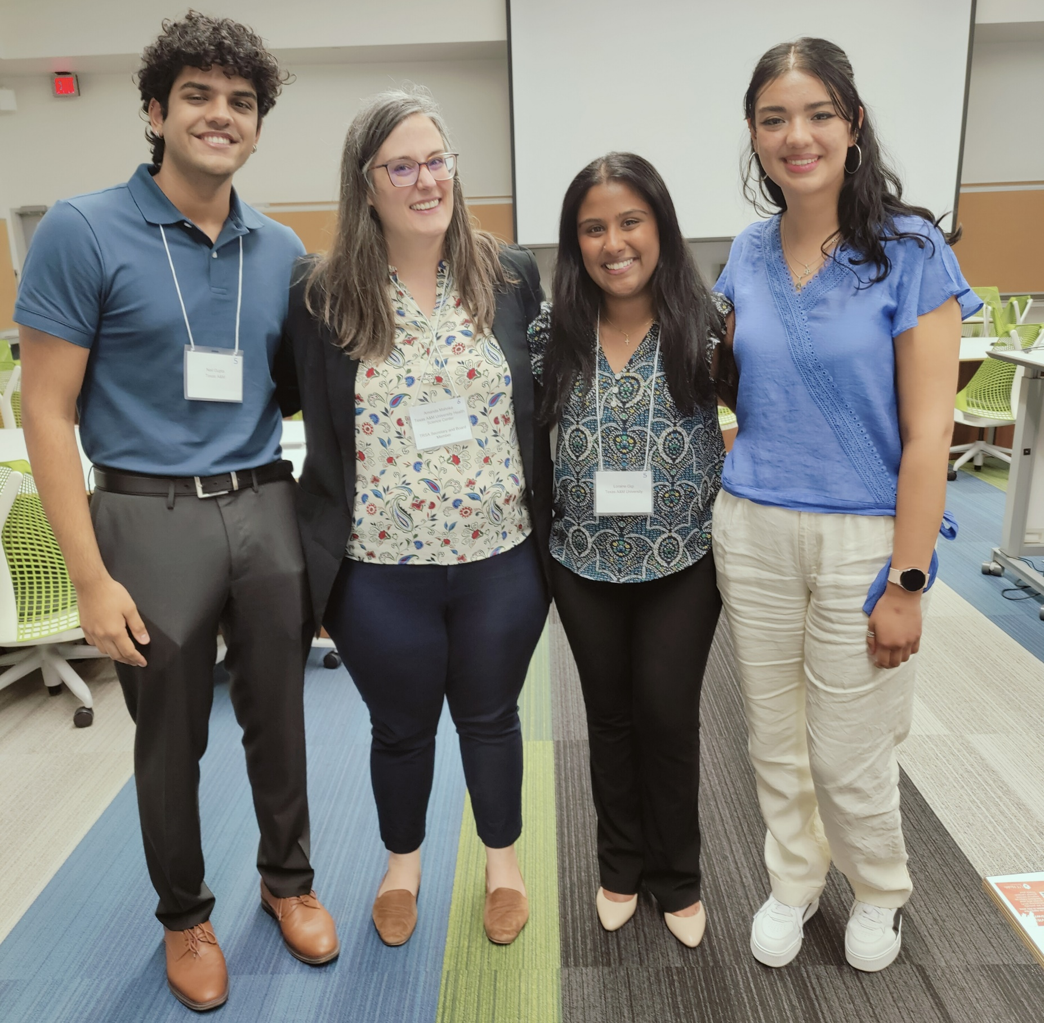



Acknowledgements
Mahnke Lab
Jade Griffin, MPH
Alexis Magre, MS
Emilie Sandfeld, BS
Neil Gupta
Renata Santiago
Jillian Anderson
Hayden Kohl
Max Cheshire, MPH
Chiara Scopice, MS
Loraine Gigi, BS
Shona Shaji, MS
Texas A&M University
Dr. Rajesh Miranda
NYU
Dr. Ralph DiClemente
UT McGovern
Dr. Angela Stotts
University of Calgary
Dr. Tamara Bodnar
Brock University
Dr. Charlis Raineki
Boston Children’s
Dr. Olivia Weeks
UCSD
Dr. Christina Chambers
Ukraine
Omni-Net
Dr. Wladimir Wertelecki
Dr. Lyubov Yevtushok
Dr. Natalya Zymak-Zakutnya
ACES Faculty Fellows Program
Start-Up funding
UH2AA030186
Notes:
https://cifasd.org/data-sharing/

Slide 20
Questions?
Amanda H. Mahnke, PhD
Assistant Professor
Department of Neuroscience and Experimental Therapeutics
mahnke@tamu.edu

Slide 21
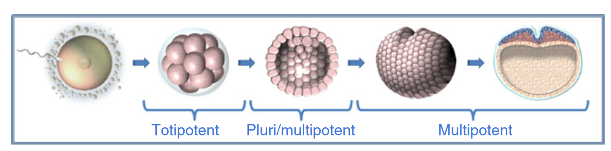
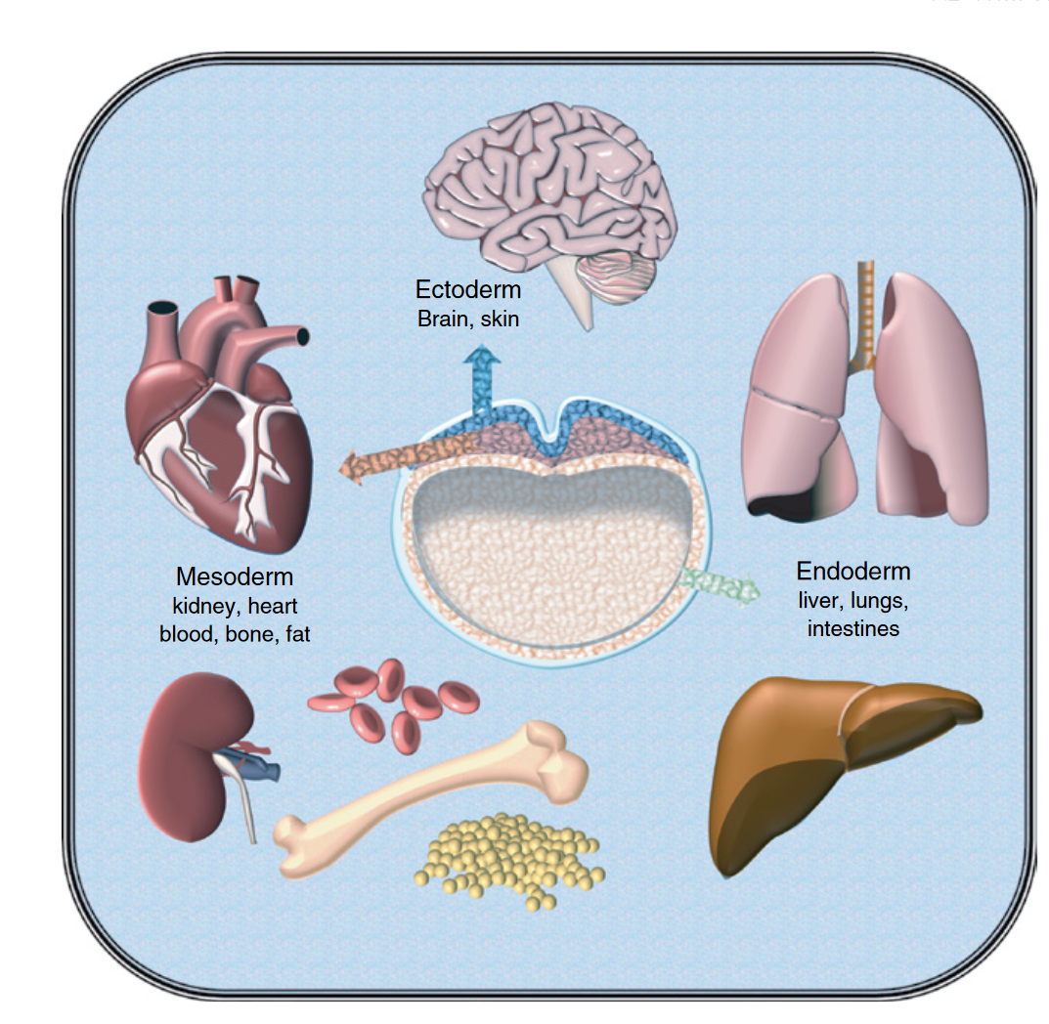
Stem cell vocabulary and early embryology primer
Mahnke, AH et al. (2018) Stem Cells in Birth Defects Research and Developmental Toxicology p223–257

