Slide 1

BRIDGING ANIMAL MODEL RESEARCH AND A CLINIC COHORT STUDY TO SUPPORT ADOLESCENTS AND ADULTS WITH FASDs
Olivia weeks, PhD
Burns Laboratory
Boston children’s hospital, Harvard Medical School

Slide 2
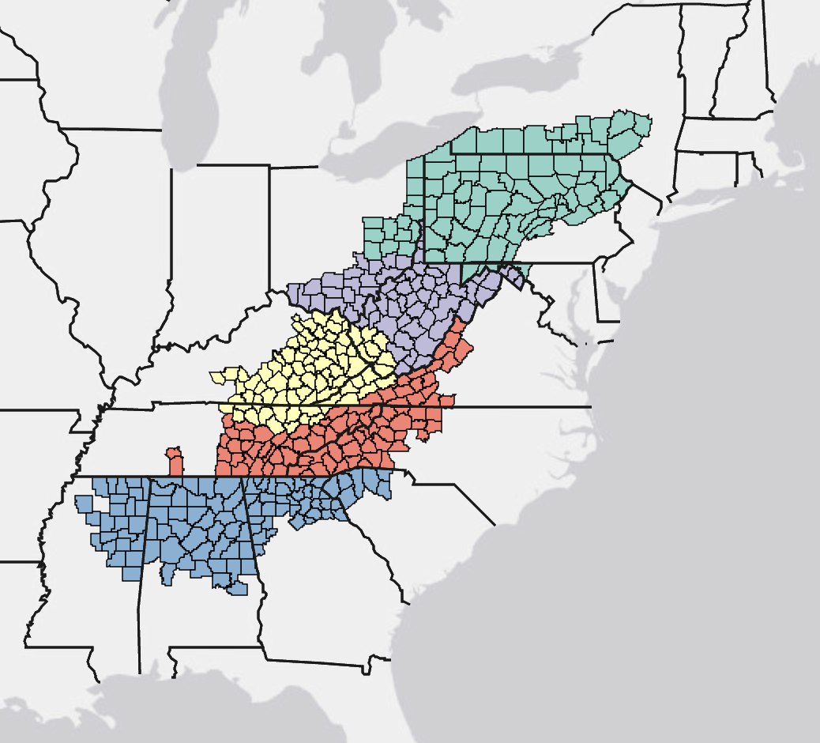


PERSONAL INTRODUCTION
Appalachia
Grew up in Northern Appalachia (rural New York)
Family had multiple generations of alcohol use disorder, alcohol-related deaths, and “fetal alcohol effects”
PhD, Developmental Biology
Metabolism, Metabolic Syndrome and Obesity In FASDs
Interests are in the intragenerational and multigenerational impacts of alcohol
Doctoral and postdoctoral research training has been focused on FASDs and alcohol-related organ damage
Postdoctoral Fellowship
Cardiovascular and Congenital Heart Disease In FASDs

Slide 3
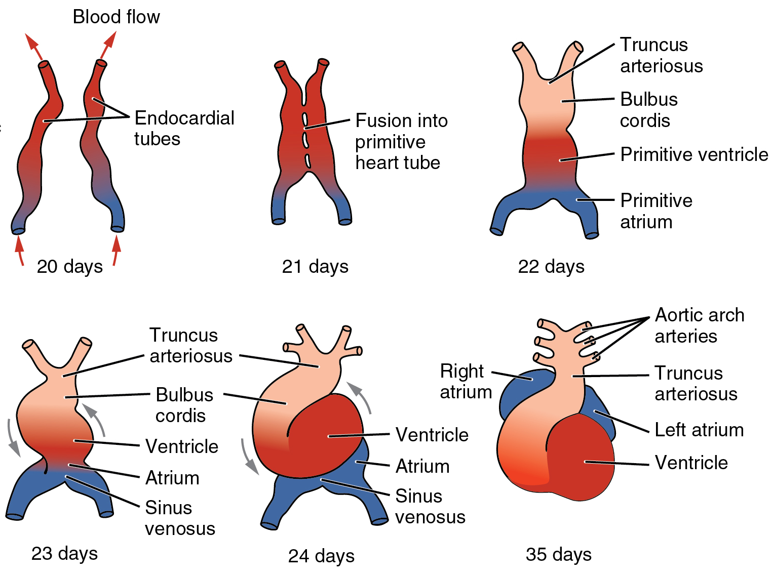
THE DEVELOPING HEART IS VULNERABLE TO ALCOHOL
  The heart is the first organ to develop in the body
  It begins to develop before many people have a confirmed pregnancy
  Children with FASDs appear to have higher rates of congenital heart defects than the general population
  Long-term impacts of PAE on adolescent and adult cardiovascular disease incidence are understudied
21 – 22 days = 1 week after a missed period
Heart Pumping
Betts JG (2013).

Slide 4
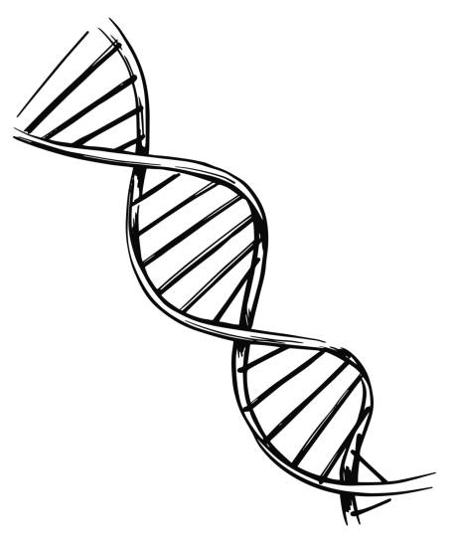
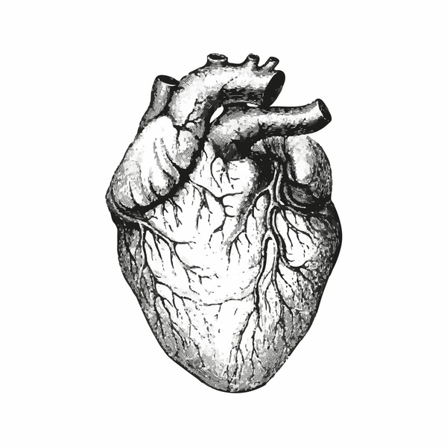

QUESTIONS ADDRESSED BY MY ONGOING RESEARCH
Why does prenatal alcohol exposure cause congenital heart defects?
Do FASDs increase the risk for adult cardiovascular diseases, including cardiomyopathy (heart muscle disease) and heart failure?
Do biomarkers exist that could help identify FASD patients who are at risk for chronic cardiovascular conditions?

Slide 5
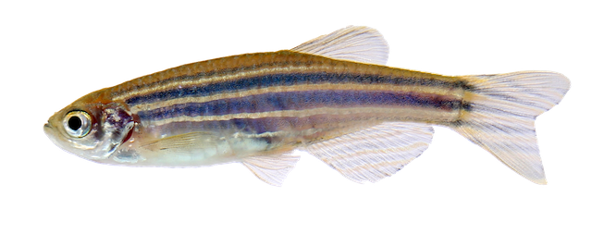
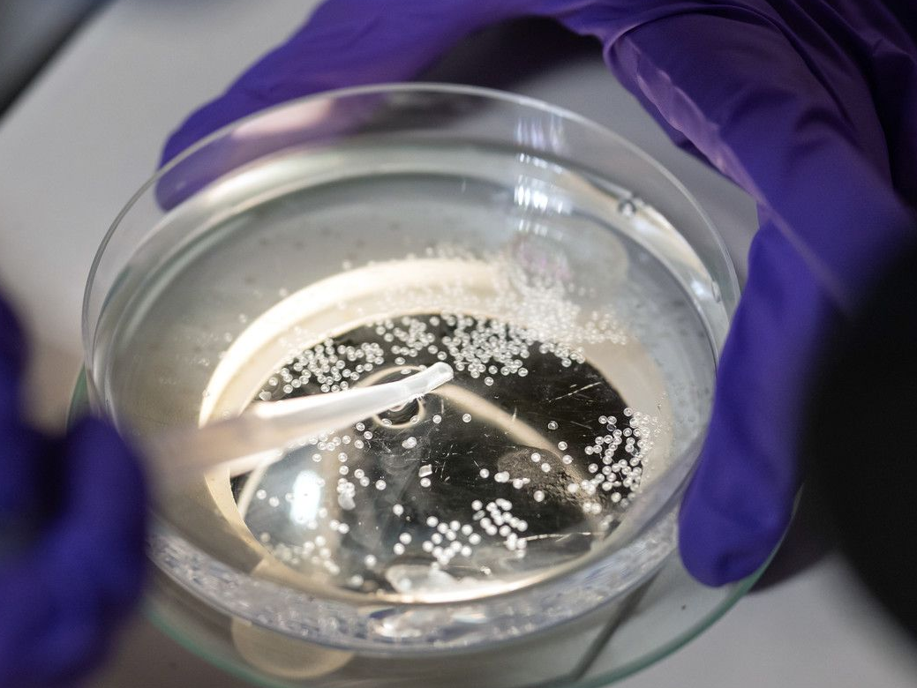
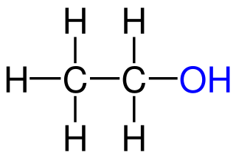
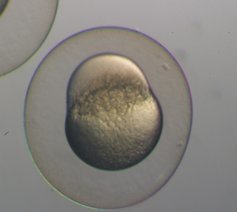
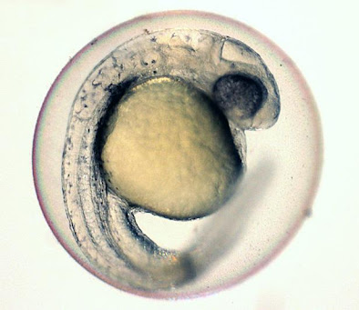
ZEBRAFISH AS A MODEL FOR EMBRYONIC ALCOHOL EXPOSURE
ZEBRAFISH
From Southeast Himalayan region
Similar organs and genes to humans
External fertilization and development
Produce many transparent embryos
Easily exposed to chemical compounds in water
EMBRYOS
head
cell
trunk
Alcohol
(EtOH)
yolk

Slide 6
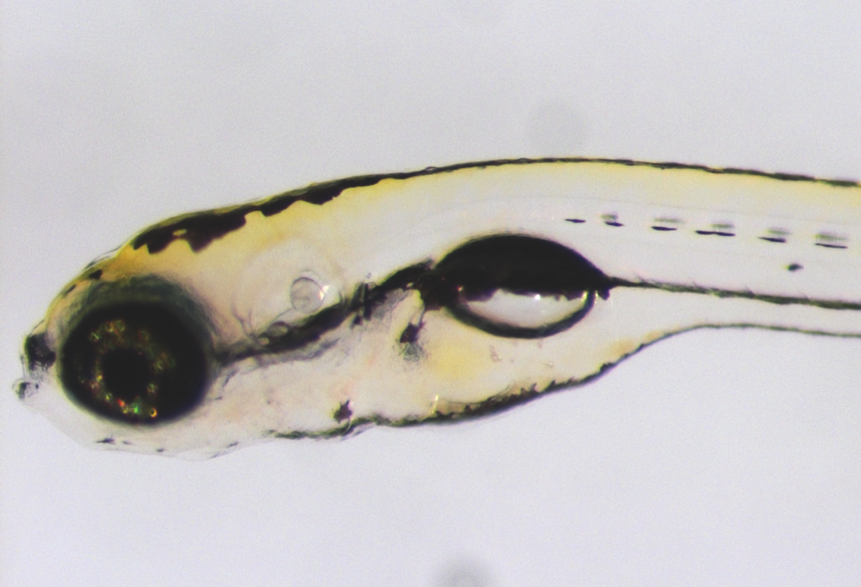
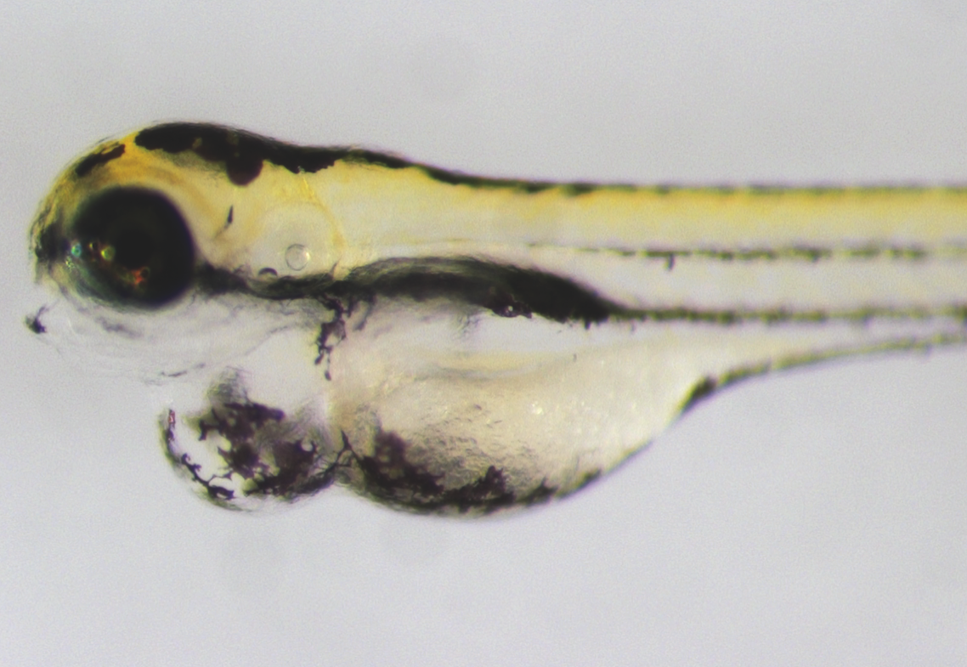
ZEBRAFISH RECAPITULATE KEY FEATURES OF FASDs
CHARACTERISTICS
Short stature
Cardiac defect
Craniofacial anomalies
Eye alterations
Altered vasculature
Hyperactivity
Atypical behavior
Altered kidney formation
NO ALCOHOL
+ALCOHOL
swim bladder
Craniofacial alterations
face
Deflated swim bladder
heart
Reduced
Eye
eye
Cardiac edema
Bilotta et al., 2004; McCarthy et al., 2013; Marrs et al., 2010; Lovely, Fernandes, Eberhart, 2016; Loucks and Ahlgren, 2012; Li et al., 2016; Dlugos and Rabin, 2007; Swartz et al., 2014; Sheehan-Rooney et al., 2013. and more.

Slide 7
HEART DEVELOPMENT IN THE ZEBRAFISH: SIMILAR TO HUMANS
2 days
1 day
14 somites
21 somites
V
AV Canal
A
Heart Cell Populations Move to the Middle
A = ATRIUM; V = VENTRICLE
Cardiac Cone
Linear Heart
Tube
Two Chambered
Heart
+ ETOH EXPOSURE
Notes:
Cardiac cone: rotation and elongation

Slide 8
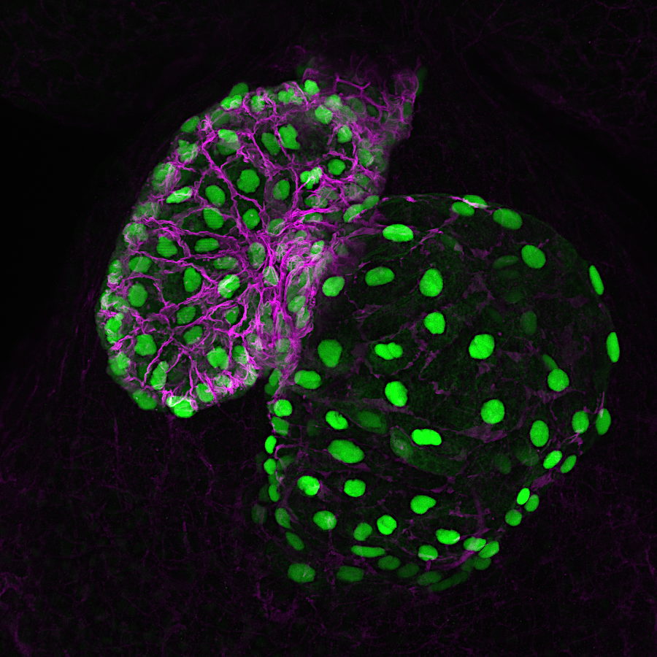
ALCOHOL EXPOSURE CAUSES CONGENITAL HEART DEFECTS IN ZEBRAFISH
NO ALCOHOL
+ALCOHOL
3 days
3 days
V
V
V
myl7:nGFP, ALCAMA
A
A
GREEN = HEART CELL NUCLEI; MAGENTA = HEART CELL MEMBRANES; A = ATRIUM; V = VENTRICLE

Slide 9
WHY DOES ALCOHOL CAUSE CONGENITAL HEART DEFECTS?
NO ALCOHOL
+ALCOHOL
NO ALCOHOL
+ALCOHOL
22ss
22ss
1 day
1 day
myl7
myl7
PURPLE = HEART CELLS
PURPLE = HEART CELLS
CARDIAC CONE
LINEAR HEART TUBE
Alcohol prevents normal migration of cardiac cells to the midline of the animal, disrupting downstream heart formation. Potential genes and pathways responsible include: PDGFRA, PI3K, and RAC1.

Slide 10
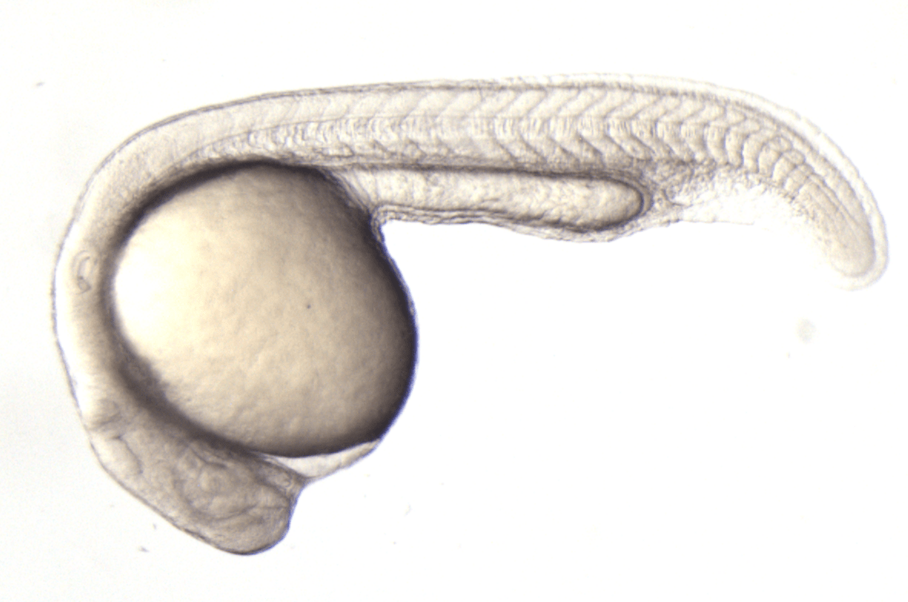
DO FASDs INCREASE THE RISK FOR ADULT CARDIOVASCULAR DISEASES?
1. GIVE ALCOHOL
2. REMOVE ALCOHOL
3. RAISE FISH
4. STUDY ADULT HEART
NO ALCOHOL
ALCOHOL
Chamber Size
Function
Wall Thickness
Gene Expression
NO ALCOHOL
ALCOHOL
Days
0
1
60
A
V
A = ATRIUM; V = VENTRICLE

Slide 11
ADULT FASD ZEBRAFISH HEARTS DEVELOP CARDIOMYOPATHY
NON - FASD
FASD
FASD HEARTS HAVE:
Enlarged atrium
Abnormal ventricle
30 – 45% have features of “cardiomyopathy”
These findings suggest that FASD patients could have an increased risk of heart problems as they age, such as cardiomyopathy/heart muscle disease.
GREEN = HEART; A = ATRIUM; V = VENTRICLE

Slide 12
ADULT FASD ZEBRAFISH HEARTS DEVELOP CARDIOMYOPATHY
NON - FASD
FASD
NON - FASD
FASD
A = ATRIUM; V = VENTRICLE
H&E HISTOLOGY STAINING
Thickened compact
myocardial wall

Slide 13
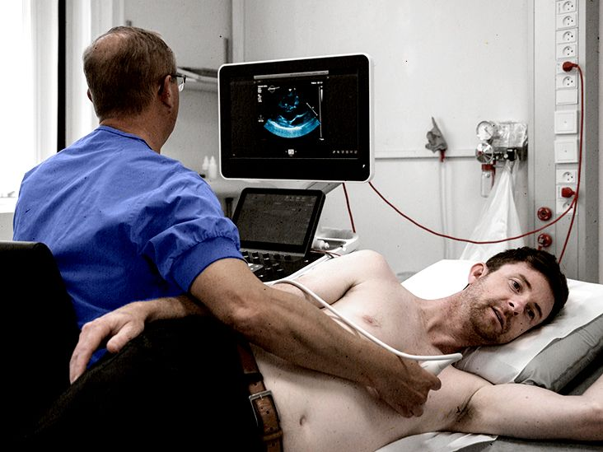
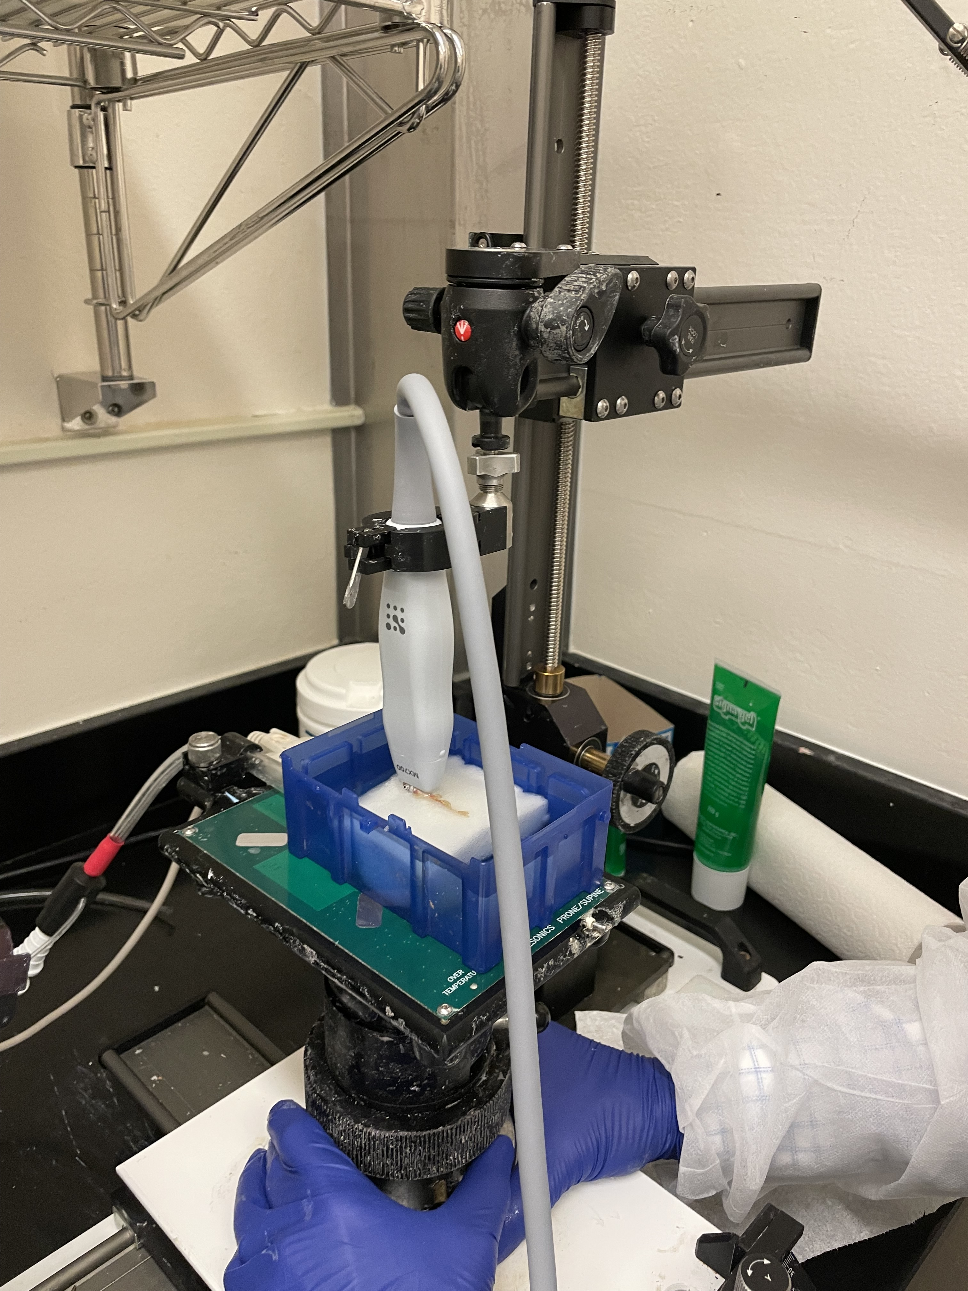
ECHOCARDIOGRAPHY IN A ZEBRAFISH
probe
fish
Medical News Today
Echocardiography uses ultrasound to take images of the beating heart to assess structure and function.

Slide 14
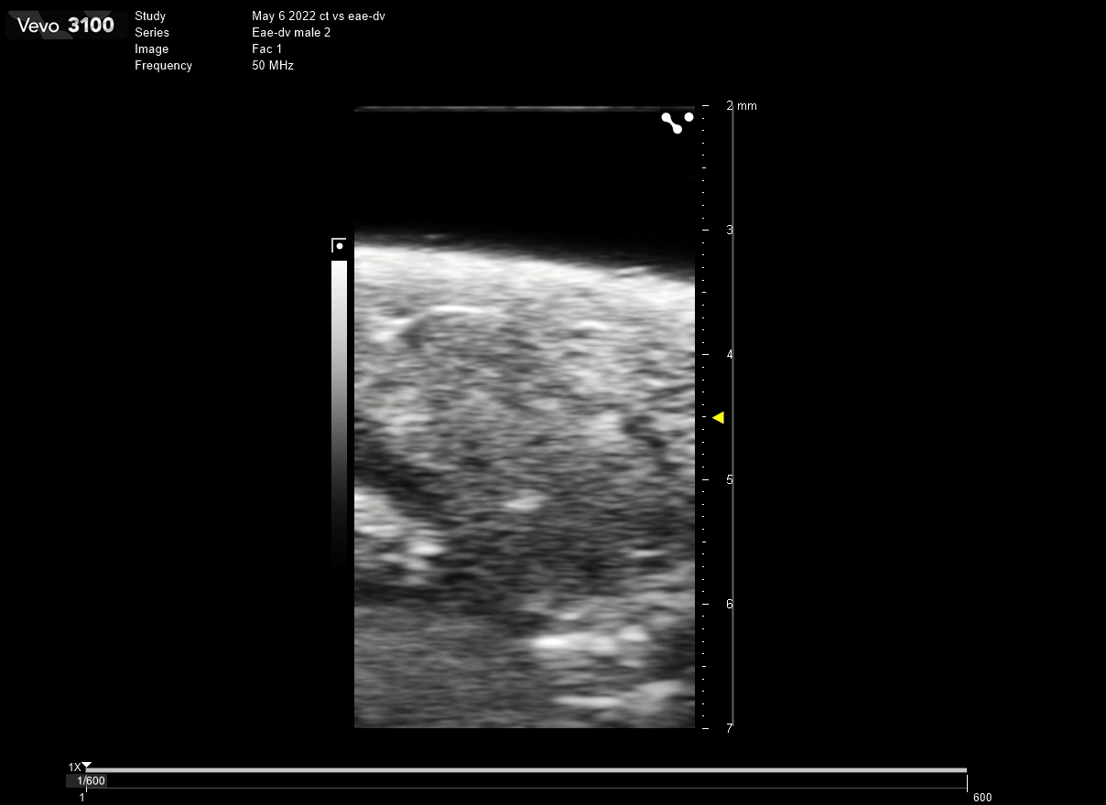
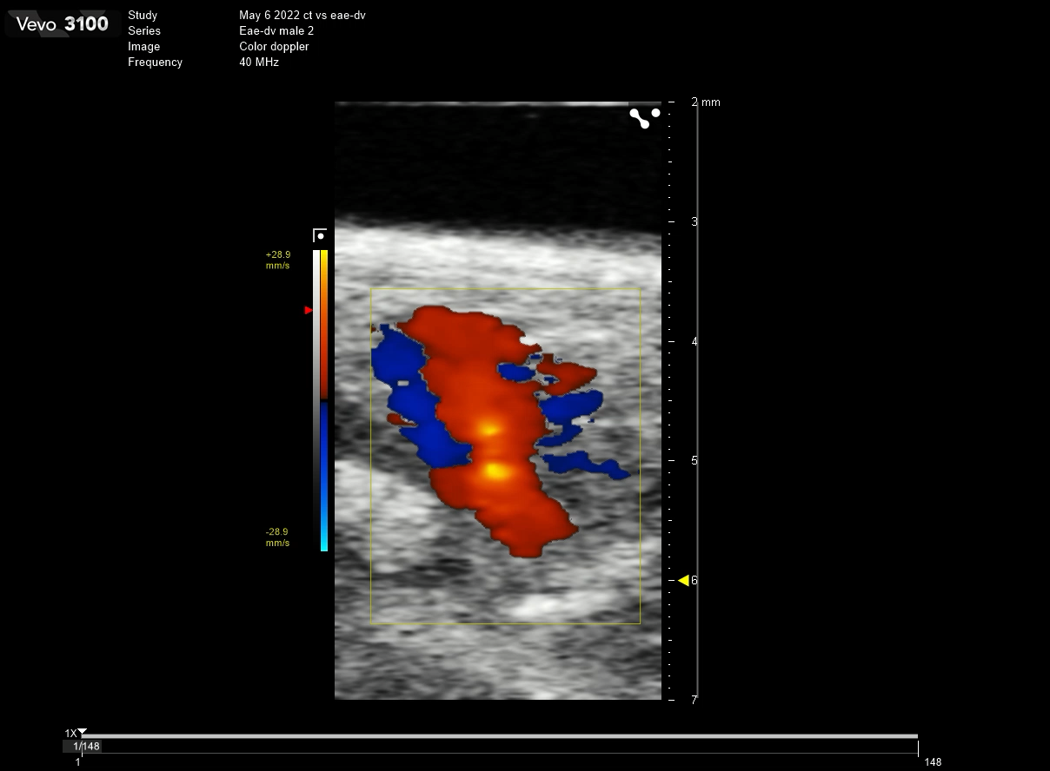
ULTRASOUND REVEALS PROBLEMS WITH FASD HEART FUNCTION
B-Mode
Color Doppler
V
BA
A
FASD zebrafish hearts contract well but relax poorly
Impaired relaxation can cause atrial enlargement and cardiomyopathy
Consistent with a diagnosis of “diastolic dysfunction”
These findings suggest that patients with FASDs could have abnormal heart function as they age, which needs to be further evaluated in clinical studies.

Slide 15
DO FASD HEARTS EXPRESS THEIR GENES DIFFERENTLY?
NON - FASD
FASD hearts have thousands of differentially expressed genes
Abnormal levels of these genes may contribute to heart dysfunction
Some genes may be biomarkers that could indicate prenatal alcohol exposure or cardiovascular disease risk:
A
V
SEQUENCED
(RNA)
FASD
A
V
slc25a33
ankrd9
spry4
eya4
edn1
dusp2
dusp4
A = ATRIUM; V = VENTRICLE
With Kaifu Chen and Xinlei Gao

Slide 16

IDENTIFYING OVERLAPPING HEALTH OUTCOMES IN ZEBRAFISH FASD MODELS AND HUMANS WITH FASDs

Slide 17

DO HUMAN FASD PATIENTS HAVE MORE CARDIOVASCULAR DISEASES?
  Found adult FASD and non-FASD patients (median study age = ~35 - 38 years old)
  Retrospectively recorded health parameters from clinic files
18 years old
Health and Diagnoses
Present
FASD
total = 207
NON – FASD
total = 831
Cardiac testing (EKG/Echo)
Congenital Heart Defect
Cardiomyopathy/Heart Failure
Arrythmia
Stroke/Embolism/Thrombosis
Height/ Weight/BMI
Overweight/Obesity
Blood glucose/A1C/Diabetes
Cholesterol/Triglycerides/Hyperlipidemia
Hypertension
  Compared health outcomes
With Wolfram Goessling, Matt Steinhauser, Pouneh Fazeli, Shaan Khurshid.

Slide 18
FASD PATIENTS ARE AT INCREASED RISK FOR CARDIOVASCULAR DISEASES
Approximately 7% of FASD patients had a congenital heart defect
Preliminarily, FASD patients had more:
Cardiovascular testing
Heart failure
Heart attack (males)
Stroke/Clot/Embolism
NO FASD
FASD
NO FASD
FASD
These findings suggest an increased cardiovascular disease burden in humans with FASDs, which is consistent with observations of cardiac dysfunction in our zebrafish model.

Slide 19
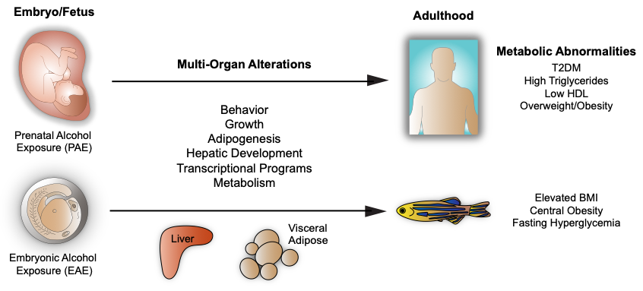
CONCLUSIONS
Cardiovascular Diseases
Cardiac Problems
Congenital heart defect
Increased cardiac testing
Heart failure
Cardiomyopathy (female)
Disrupted heart development
Changes in heart structure
Progressive heart dysfunction
Altered gene expression
Congenital heart defect
Cardiomyopathy
Diastolic dysfunction

Slide 20

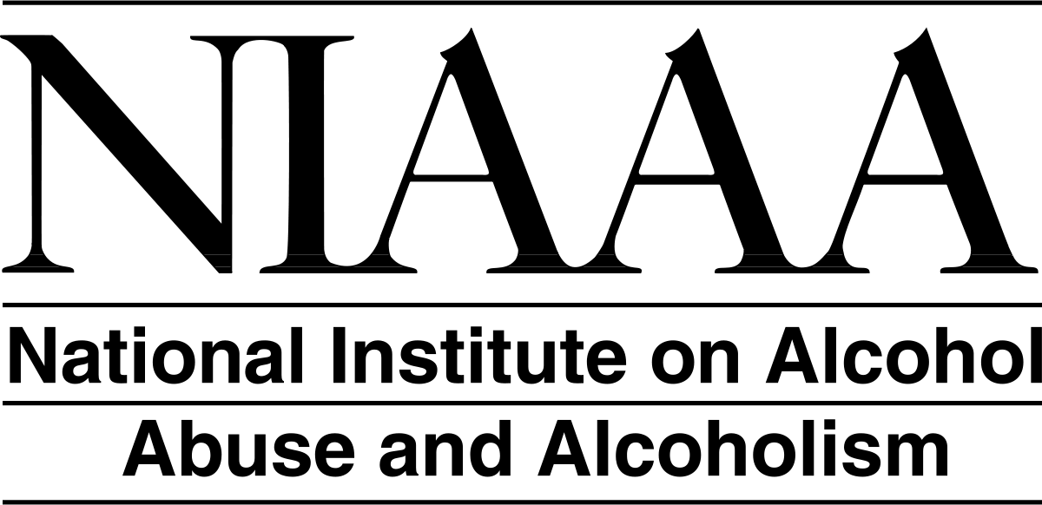


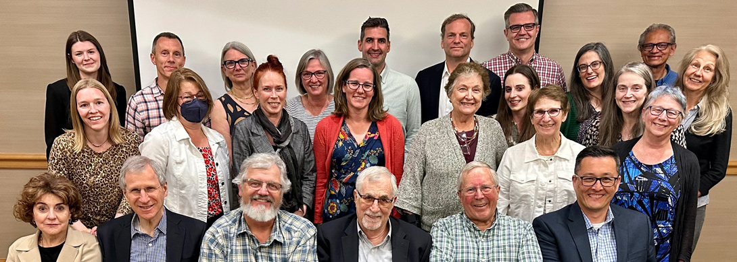
ACKNOWLEDGEMENTS
Funding
NIH, T32, Ruth L. Kirschstein Institutional National Research Service Award
CIFASD/NIAAA U01
American Heart Association Postdoctoral Fellowship
Burns Laboratory
Caroline E. Burns, PhD
C. Geoffrey Burns, PhD
Jen Galdieri
Hui-Min Yin, PhD
Hakan Coskun, PhD
Mengmeng Huang, PhD
Felicia Wranitz
Amey Rayrikar, PhD
Feria Ladha, PhD
Mass General Brigham
Wolfram Goessling, MD, PhD
Marc Sherman, MD, PhD
Shaan Khurshid, MD, MPH
CIFASD
*All CIFASD5 members*
Michael Charness, MD
Edward Riley, PhD
Leah Wetherill, PhD, MS, MA
Abigail (Abby) Erickson, BS, CCRP
Boston Children’s Hospital
Xinlei Gao, PhD
Kaifu Chen, PhD
Vassilios Bezzerides, MD, PhD
William (Bill) Pu, MD

Slide 21

For information on available archived CIFASD data, please visit https://cifasd.org/data-sharing/.
Information on accessing CIFASD research data

